Slide 1


WCL RVP TOPS Training
WCL RVP Team
WW19Y2025
Rev1.1 (Updated on WW20.5’25)

Slide 2

Contents
Introduction
SKU Offerings
High level RVP overview
Board Layout
Memory
Display
Modular TCSS
Type C TBT
HSIO mapping
Storage
UFS
Connectivity
Audio
SPI Flash & TPM
15. Sensors
16. LPSS and LSIO
17. Embedded Controllers
18. Chrome Support
19. Debug and Validation
20. Power Delivery
21. Quick Start
22. WCL SOC & Memory Retention Solution
23. Jumper, Switch & LED details
24. WCL SOC straps
25. RVP NEST
26. Back-up
Notes:
RVP NEST
UCP - backup

Slide 3
WCL RVP Key Contacts
Program Management Team
Sundarabhattar, Sinkaravelan [BA]
Design/Engineering Manager
Liew, Jia Lin [PG]
RVP Architect:
Sharma, Deepak [BA]
Parameswaran, Pharveen [PG]
PD Architect:
Tan, Adrian [PG]
DE Lead:
Zakaria, Anas [PG]
PD Lead:
Au, Chun Ming [PG]
DE Team:
CH, Manjunath [BA]
Jadhav, Aniket [BA]
K S, Vachana [BA]
Li, Kok Wai Ryan [PG]
Lim, Kok Leng [PG]
Mechanical Team:
Kaja, Ajmeer (RVP)
Raupp, James C (MTEG)
Burman, Stuart D (MTEG)
Layout Team
Lee, Poh Ling – RVP1 [PG]
Selvaraj, Balaji – RVP2 [BA]
Validation Team:
R, Hemananth [BA] (CSF / Validation Lead)
M, Ramesh S [BA] (Validation Manager)
MPM/ME/Factory Team:
Ch’ng, Ee Hwa (MPM)
B Chandrashekar (ME)
Tran, Michelle (OPM)
Ulaganathan, Nachiappan (Factory test lead)
M, Prakash (Factory test)

Slide 4
Important Links [goto/rvp]
WCL RVP SharePoint link:
https://intel.sharepoint.com/:f:/r/sites/ccg_cpe_cps_wclsystempdt/Shared%20Documents/RVP%20Engineering%20Docs?csf=1&web=1&e=rIJhnj
WCL Architecture document link:
https://intel.sharepoint.com/:f:/r/sites/ccg_cpe_cps_wclsystempdt/Shared%20Documents/RVP%20Engineering%20Docs/RVP%20Architecture%20Docs?csf=1&web=1&e=QEMKUx
WCL RVP SOC and EC GPIO mapping link:
https://intel.sharepoint.com/:f:/r/sites/ccg_cpe_cps_wclsystempdt/Shared%20Documents/RVP%20Engineering%20Docs/WCL-Platform%20Mapping%20documents?csf=1&web=1&e=hoJmPK
WCL RVP Schematics link:
https://intel.sharepoint.com/:f:/r/sites/ccg_cpe_cps_wclsystempdt/Shared%20Documents/RVP%20Engineering%20Docs/WCL-Sch?csf=1&web=1&e=bfavpV
WCL RVP Layout link:
https://intel.sharepoint.com/:f:/r/sites/ccg_cpe_cps_wclsystempdt/Shared%20Documents/RVP%20Engineering%20Docs/WCL-Layout?csf=1&web=1&e=xdKYJx
WCL TOPS File & Recording link:
https://intel.sharepoint.com/:f:/r/sites/ccg_cpe_cps_wclsystempdt/Shared%20Documents/RVP%20Engineering%20Docs/TOPS?csf=1&web=1&e=DcLGEH

Slide 5
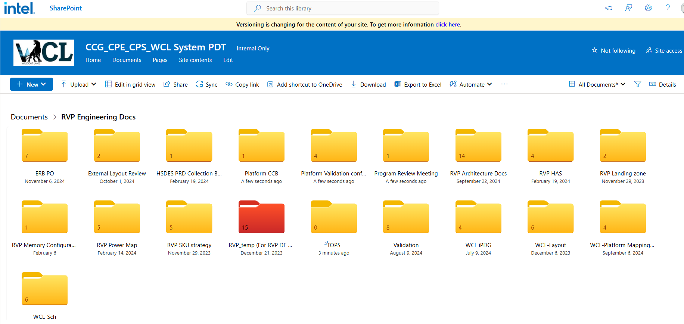
WCL RVP SharePoint
Feature List for WCL RVP is available in architecture document as well as in Landing Zone(LZ).
Architecture document is available at WCL RVP SharePoint at following mention link.
Link: https://intel.sharepoint.com/:f:/r/sites/ccg_cpe_cps_wclsystempdt/Shared%20Documents/RVP%20Engineering%20Docs?csf=1&web=1&e=rIJhnj

Slide 6
SKU Offerings
Zakaria, Anas

Slide 7
WCL RVP SKU Offering
RVP SKU | SKW | SKU Description | Remarks
RVP1: WCL DDR5 SODIMM T3
RVP1a | U-01 | WCL DDR5 SODIMM T3 RVP | iPOR= 7200Mbps, 16GB Memory
RVP1c – BOM SKU | U-03 | WCL DDR5 SODIMM T3 RVP PnP SKU | 16GB Memory
RVP1d – BOM SKU | U-11 | WCL DDR5 SODIMM T3 RVP Chrome SKU | 8GB memory
RVP2 : WCL LP5x T3
RVP2a | U-04 | WCL LP5x MD, x32, T3 RVP | Volume Runner. iPOR = 8000Mbps, 16GB Memory
RVP2b – BOM SKU | U-05 | WCL LP5x Socketed SKU | Deployment for EV, for different memory validation, 16GB Memory
RVP2c – BOM SKU | U-06 | WCL LP5x MD Chrome SKU | 2x 4GB = 8GB memory
RVP2d – BOM SKU | U-07 | WCL LP5x Socketed Chrome SKU | 2x 8GB = 16GB memory
RVP2e – BOM SKU | U-08 | WCL LP5x MD HSIO SKU | No separate HSIO RVP, requirement covered through BOM stuffing option, 16GB Memory
RVP2f – BOM SKU | U-09 | WCL LP5x MD PnP SKU | 16GB Memory
RVP2g – BOM SKU | U-10 | WCL LP5x MD MECC SKU | MECC AIC BOM Changes Intercepted, 16GB Memory
RVP2h – BOM SKU | U-02 | WCL LP5x MD PPV SKU | 16GB Memory
Link: WCL-RVP-Offerings
Notes:
Add IPNs for the PB/PBA/AA/TA

Slide 8
Boot KIT: WCL RVP1 DDR5 SODIMM
Sr. No. | Item Type | IPN | Item Description | Qty
1 | NEW_BIZ_RDV | N50418-001 | BOOT KIT, WCL RVP1 DDR5 SODIMM,RVP | 1
2 | ISC Socket | N53025-001 | SKT,ISC,ELASTOMER,WCL, | 1
3 | Socket Retention HW | N53026-001 | RETENTION HARDWARE,WCL, ELASTOMER, RVP | 1
4 | MEMORY | N26151-002 | DDR5SODIMM,MOD,1RX8 NE,1.1V,6400Mbps,262, | 1
5 | USB2 FP Cable | K56424-001 | CA,USB2,FCC TO BOTTOM IO,FAST X36,FP3,200MM | 1

Slide 9
Boot KIT: WCL RVP1 DDR5 SODIMM CHROME
Sr. No. | Item Type | IPN | Item Description | Qty
1 | NEW_BIZ_RDV | N50418-001 | BOOT KIT, WCL RVP1 DDR5 SODIMM,RVP | 1
2 | ISC Socket | N53025-001 | SKT,ISC,ELASTOMER,WCL, | 1
3 | Socket Retention HW | N53026-001 | RETENTION HARDWARE,WCL, ELASTOMER, RVP | 1
4 | MEMORY | N25690-002 | DDR5SODIMM,MOD,1RX16NE,1.1V,6400Mbps,262, | 1
6 | USB2 FP Cable | K56424-001 | CA,USB2,FCC TO BOTTOM IO,FAST X36,FP3,200MM | 1

Slide 10
Boot KIT: WCL RVP2 LP5x T3 RVP MEM SD
Sr. No. | Item Type | IPN | Item Description | Qty
1 | NEW_BIZ_RDV | N50420-001 | BOOT KIT, WCL RVP2 LP5X MD,RVP | 1
2 | ISC Socket | N53025-001 | SKT,ISC,ELASTOMER,WCL, | 1
3 | Socket Retention HW | N53026-001 | RETENTION HARDWARE,WCL, ELASTOMER, RVP | 1
4 | USB2 FP Cable | K56424-001 | CA,USB2,FCC TO BOTTOM IO,FAST X36,FP3,200MM | 1

Slide 11
Boot KIT: WCL RVP2 LP5x T3 RVP MEM SKT
Sr. No. | Item Type | IPN | Item Description | Qty
1 | NEW_BIZ_RDV | N50448-001 | BOOT KIT, WCL RVP2 LP5X SKT,RVP | 1
2 | ISC Socket | N53025-001 | SKT,ISC,ELASTOMER,WCL, | 1
3 | Socket Retention HW | N53026-001 | RETENTION HARDWARE,WCL, ELASTOMER, RVP | 1
4 | USB2 FP Cable | K56424-001 | CA,USB2,FCC TO BOTTOM IO,FAST X36,FP3,200MM | 1
5 | Mem Socket | M15275-001 | SOCKET,315BGA, LPDDR5,,ELASTOMER | 2
6 | Mem Retention HW | N58027-001 | RETENTION ASSY, 315BGA LPDDR5,2X, 26.1MM SPACING, CIS ALIGN | 1
7 | MEMORY | N44159-001 | MEMORY IC,N/A,MEM,BL,LPDDR5,N/A,N/A,FBGA,315, | 2
Note:
Please note that memory part will be same for LP5x T3 MD and LP5x T3 MEM SKT.

Slide 12
Boot KIT: WCL RVP2 LP5x T3 RVP MEM SKT CHROME
Sr. No. | Item Type | IPN | Item Description | Qty
1 | NEW_BIZ_RDV | N54539-001 | BOOT KIT, WCL RVP2 LP5X SKT,RVP | 1
2 | ISC Socket | N53025-001 | SKT,ISC,ELASTOMER,WCL, | 1
3 | Socket Retention HW | N53026-001 | RETENTION HARDWARE,WCL, ELASTOMER, RVP | 1
4 | USB2 FP Cable | K56424-001 | CA,USB2,FCC TO BOTTOM IO,FAST X36,FP3,200MM | 1
5 | Mem Socket | M15275-001 | SOCKET,315BGA, LPDDR5,,ELASTOMER | 2
6 | Mem Retention HW | N58027-001 | RETENTION ASSY, 315BGA LPDDR5,2X, 26.1MM SPACING, CIS ALIGN | 1
7 | MEMORY | N44159-001 | MEMORY IC,N/A,MEM,BL,LPDDR5,N/A,N/A,FBGA,315, | 2
Note:
Please note that memory part will be same for LP5x T3 MD and LP5x T3 MEM SKT.

Slide 13
Boot KIT: WCL RVP2 LP5x T3 RVP MEM SD CHROME
Sr. No. | Item Type | IPN | Item Description | Qty
1 | NEW_BIZ_RDV | N50420-001 | BOOT KIT, WCL RVP2 LP5X MD,RVP | 1
2 | ISC Socket | N53025-001 | SKT,ISC,ELASTOMER,WCL, | 1
3 | Socket Retention HW | N53026-001 | RETENTION HARDWARE,WCL, ELASTOMER, RVP | 1
4 | USB2 FP Cable | K56424-001 | CA,USB2,FCC TO BOTTOM IO,FAST X36,FP3,200MM | 1
Note:
Please note that MEM SD Chrome Boot Kit is same as WCL LP5x T3 RVP MEM SD main SKU

Slide 14
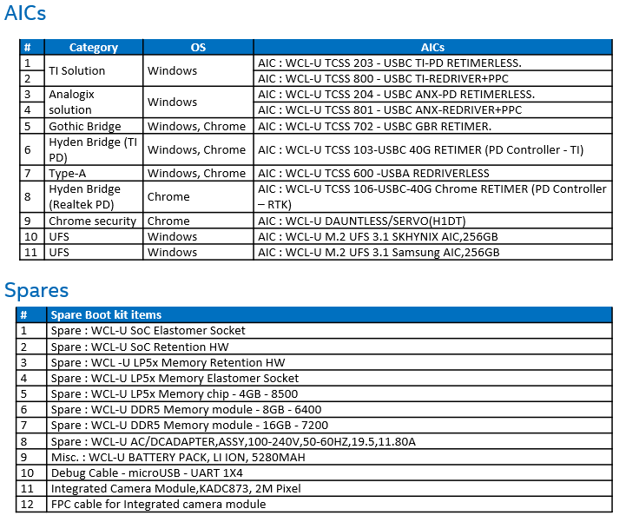
AIC’s/ KIT supported along with WCL RVP
Link: WCL-RVP-Offerings

Slide 15
High Level WCL RVP Overview
Zakaria, Anas

Slide 16
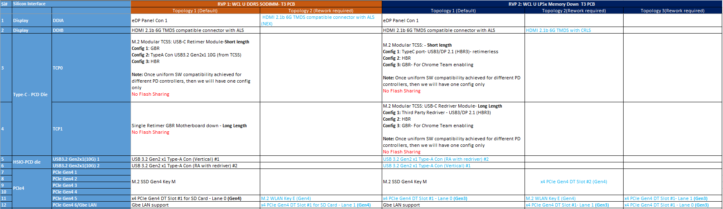
Difference across WCL RVP SKUs
Changes wrt. SKU highlighted in blue color and BOM SKU difference
Link:
WCL_RVP_LZ_Rev1p0

Slide 17
WCL RVP (LP5x T3) Block Diagram
- Golden Config

Slide 18
WCL RVP (DDR5 SODIMM T3) Block Diagram

Slide 19
Board Layout
Zakaria, Anas
Lee, Poh Ling
Selvaraj, Balaji

Slide 20
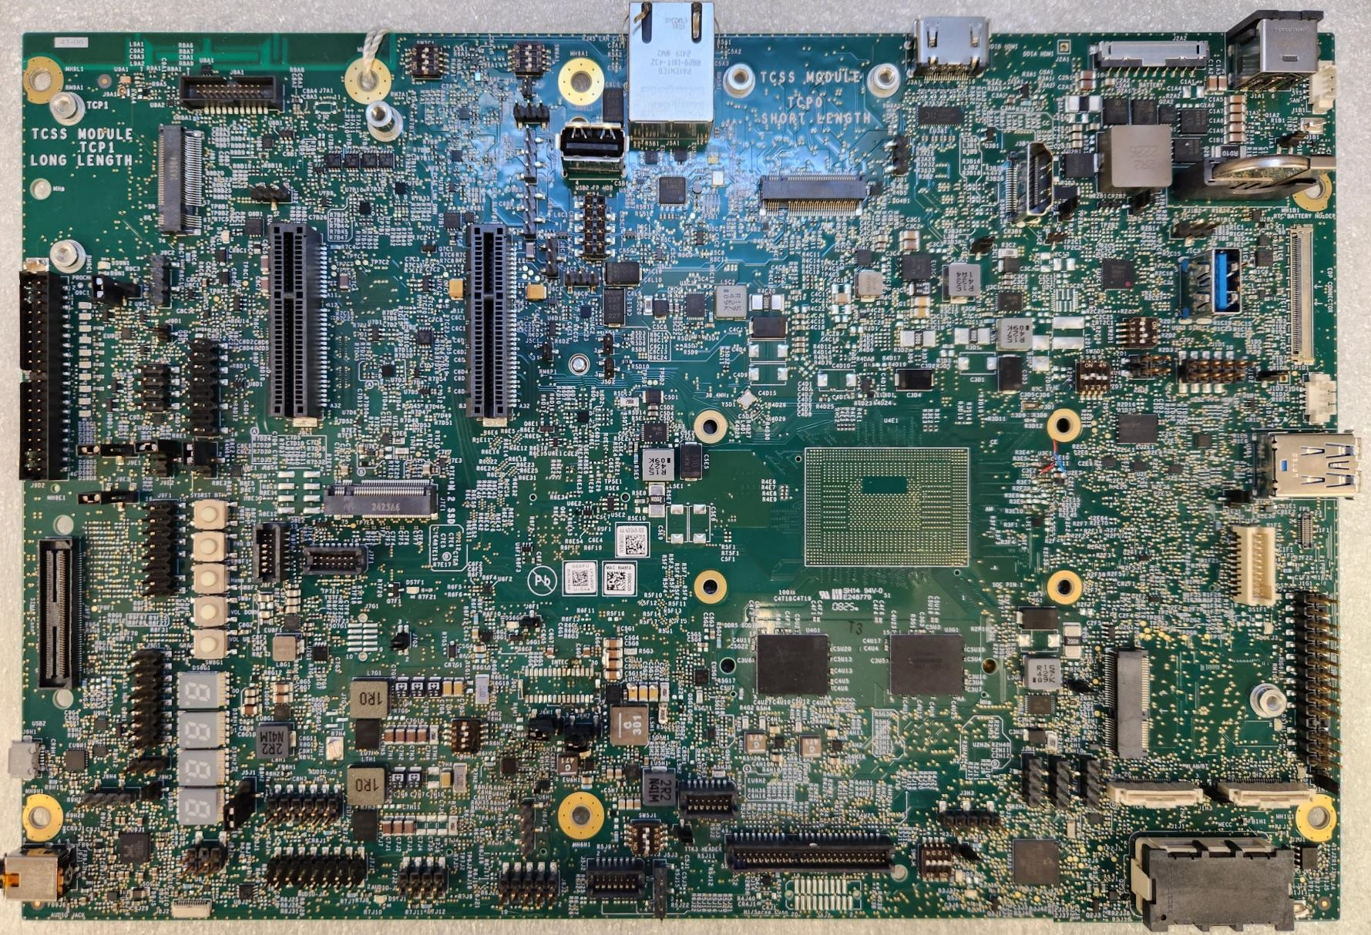
WCL LP5x T3 RVP-Board Layout – TOP
Note:
Rework Option Config**
USB Camera** Con - J7A2
TCSS AIC 1 PD Address (SW6A1)
RJ45 LAN
Con – J5A1
HDMI Con 1 (J3A1)
Battery
Connector
(J2A2)
Main AC BRICK-
Power Adapter -J1A1
RFID Antenna
HDMI** Con 2 (J3B2)
FAN HDR (Always ON)-J1A2
2x11 MCIO HDR** (J8A1)
USB2 Type-A PPV** (J6B2)
Modular TCSS AIC 1 (J4B1)
TCP0 port
Adapter Present Signal (J1A3)
Modular TCSS AIC 2 (J8B1)
TCP1 port
RTC Coin Cell
XJ1B2
USB2 FP HDR #1 (J6B4)
eDP conn (J1C2)
USB 3.2 Gen2 x1 Type-A Con - # 1 (J1C3)
x4 PCIE Slot 1 (J8C1)
x4 PCIE Slot 2** (J6C3)
PM sideband header (J9D2)
SVID HDR (J2D1)
FP HDR (J8D1)
USB2 FP** HDR #2 (J1D1)
FAN HDR (PWM control)-J1A1
WCL SOC
USB 3.2 Gen2 x1 Type-A Con with Redriver - # 2 (J1E1)
SRTC_RST Jumper (J9E2)
M.2 SSD Gen4 Con (J7E1)
QR code &
Work Order#
Reset Button(SW8E1), Power Button(SW8F1), Home Button(SW8F2), Volume Down(SW8F3), Volume Up (SW8G1)
Fingerprint Sensor Con - J1F1
PnP HDR (J7F1)
DediProg
Conn (SF600)-J1F2
SINAI2/NEVO Conn(J9F2)
PnP HDR (J8F1)
MLINK HDR **
(J7G1)
INTEC HDR (J6G1)
LP5x Memory
WLAN module- J2G2
ESPI Bus HDR** (J1G1)
Mic Privacy HDR (J5J1)
uAB Debug
port (J9H1)
PORT 80
JS HDR (J8H1)
PnP HDR (J5H1)
THC 0 Conn
J2H3
THC 1 Conn
J1H2
TTK3 Conn (J4J1)
3.5mm AUDIO JACK (J9J1)
Board Size: 7.35x11inch
Layer: 12L (6 POR x 6 Val)
MECC Conn
J1J1
JA HDR (J7J1)
JD HDR (J7J2)
JH HDR (J8J1)
JE HDR (J6J2)
PnP HDR (J5J2)
H1 SERVO HDR (J4J2)

Slide 21
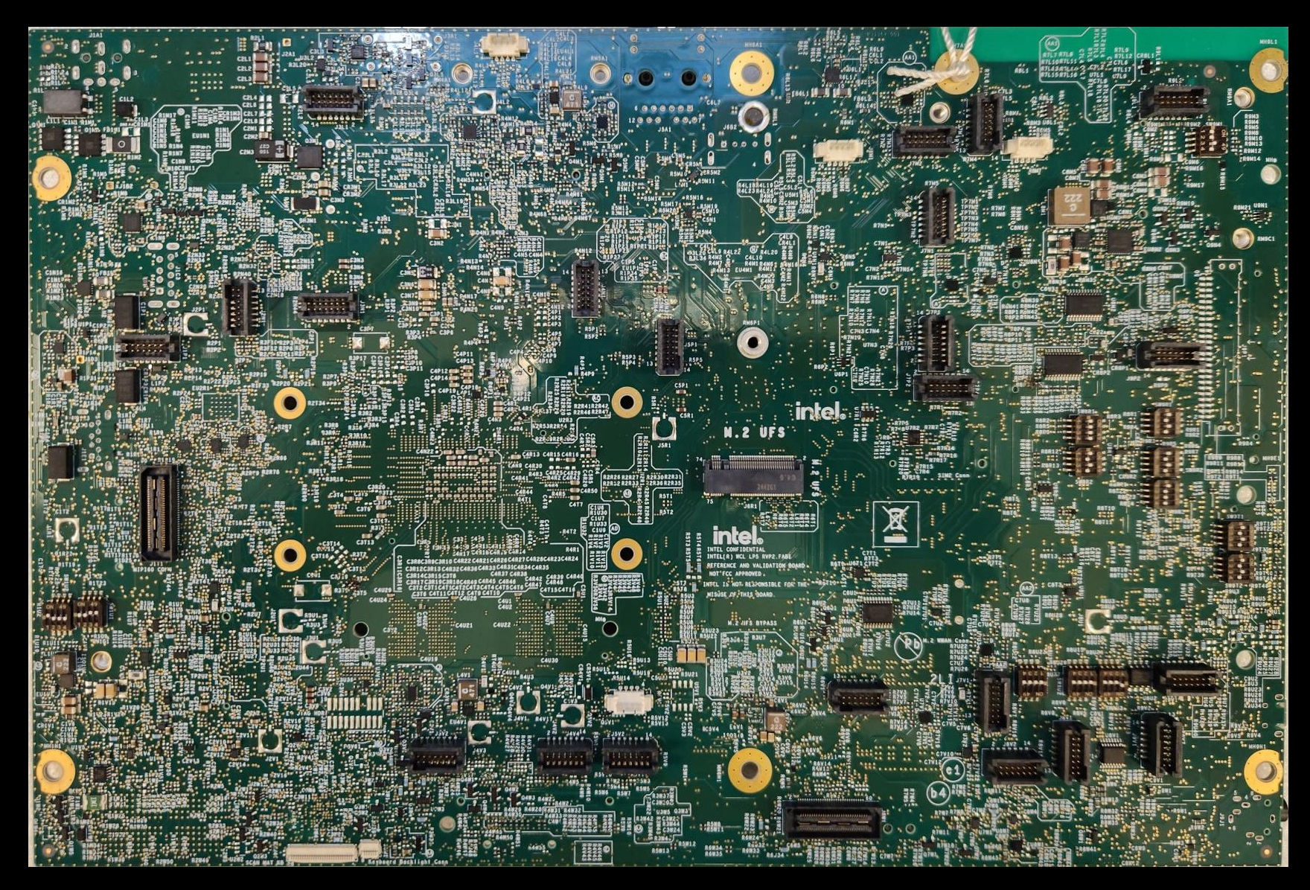
WCL LP5x T3 RVP-Board Layout – BOTTOM (Flipped)
Note:
Rework Option Config**
PnP HDR (J3L1)
PnP HDR (J9L1)
PnP HDR (J7M2)
PnP HDR (J7M1)
TCSS AIC 2 PD Address (SW9M1)
PnP HDR (J7N1)
PnP HDR (J2N1)
PnP HDR (J3N1)
PnP HDR (J4N1)
PnP HDR (J1P1)
PnP HDR (J5P1)
PnP HDR (J7P1)
PnP HDR (J9P2)
PD validation header** (J9P1)
PnP HDR (J7P2)
M.2 UFS Discrete Con (J6U1)
MIPI 60 Conn (J1T1)
Cortex Debug Conn** (J3V1)
PnP HDR (J6V1)
PnP HDR (J9U1)
PnP HDR (J7V1)
PnP HDR (J3V2)
PnP HDR (J4V4)
PnP HDR (J5V2)
PnP HDR (J9V1)
PnP HDR (J8V2)
PnP HDR (J8V1)
Sensor HDR (J6W1)
Board Size: 7.35x11inch
Layer: 12L (6 POR x 6 Val)
Scan Matrix Conn (J3W2)
KBD BKLT Conn (J3W1)

Slide 22
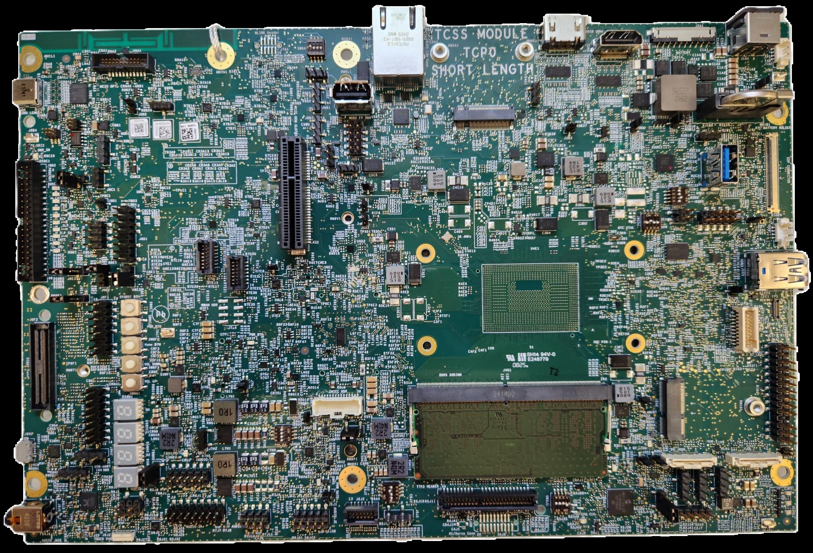
WCL DDR5 SODIMM T3 RVP-Board Layout – TOP
Note:
Rework Option Config**
USB Camera** Con - J7A2
RJ45 LAN
Con – J5A1
HDMI Con 1 (J3A1)
HDMI** Con 2 (J3A2)
Battery
Connector
(J2A1)
Main AC BRICK-
Power Adapter -J1A1
TCSS AIC 1 PD Address (SW6A1)
RFID Antenna
FAN HDR (Always ON)-J1A2
MLINK
HDR** (J7A1)
Modular TCSS AIC 1 (J4B1)
TCP0 port
2x11 MCIO HDR** (J8A1)
USB2 Type-A PPV** (J6B2)
Adapter Present Signal (J1A3)
TCP port 1 (J9B1)
RTC Coin Cell
XJ1B2
GBR Dediprog Prog HDR (J9B3)
USB2 FP HDR #1 (J6B4)
eDP conn (J1C2)
QR code &
Work Order#
USB 3.2 Gen2 x1 Type-A Con - # 1 (J1C3)
x4 PCIE Slot 1 (J6C3)
PM sideband header (J9D2)
PnP HDR (J7E1)
SVID HDR (J2D1)
FP HDR (J8D1)
USB2 FP** HDR #2 (J1D1)
FAN HDR (PWM control)-J1A1
WCL SOC
USB 3.2 Gen2 x1 Type-A Con with Redriver - # 2 (J1E1)
SRTC_RST Jumper (J9E2)
PnP HDR (J7E3)
Reset Button(SW8E1), Power Button(SW8F1), Home Button(SW8F2), Volume Down(SW8F3), Volume Up (SW8G1)
Fingerprint Sensor Con - J1F1
DediProg
Conn (SF600)-J1F2
SINAI2/NEVO Conn(J9F2)
INTEC HDR (J6G1)
DDR5 SODIMM (J4G1)
WLAN module- J2G2
ESPI Bus HDR** (J1G1)
Mic Privacy HDR (J7H3)
uAB Debug
port (J9H1)
PORT 80
JS HDR (J8H1)
THC 0 Conn
J2H3
THC 1 Conn
J1H2
TTK3 Conn (J4J1)
3.5mm AUDIO JACK (J9J1)
Board Size: 7.35x11inch
Layer: 12L (6 POR x 6 Val)
JA HDR (J7J1)
JD HDR (J7J2)
JH HDR (J8J1)
JE HDR (J6J3)
PnP HDR (J6J2)
H1 SERVO HDR (J4J2)

Slide 23
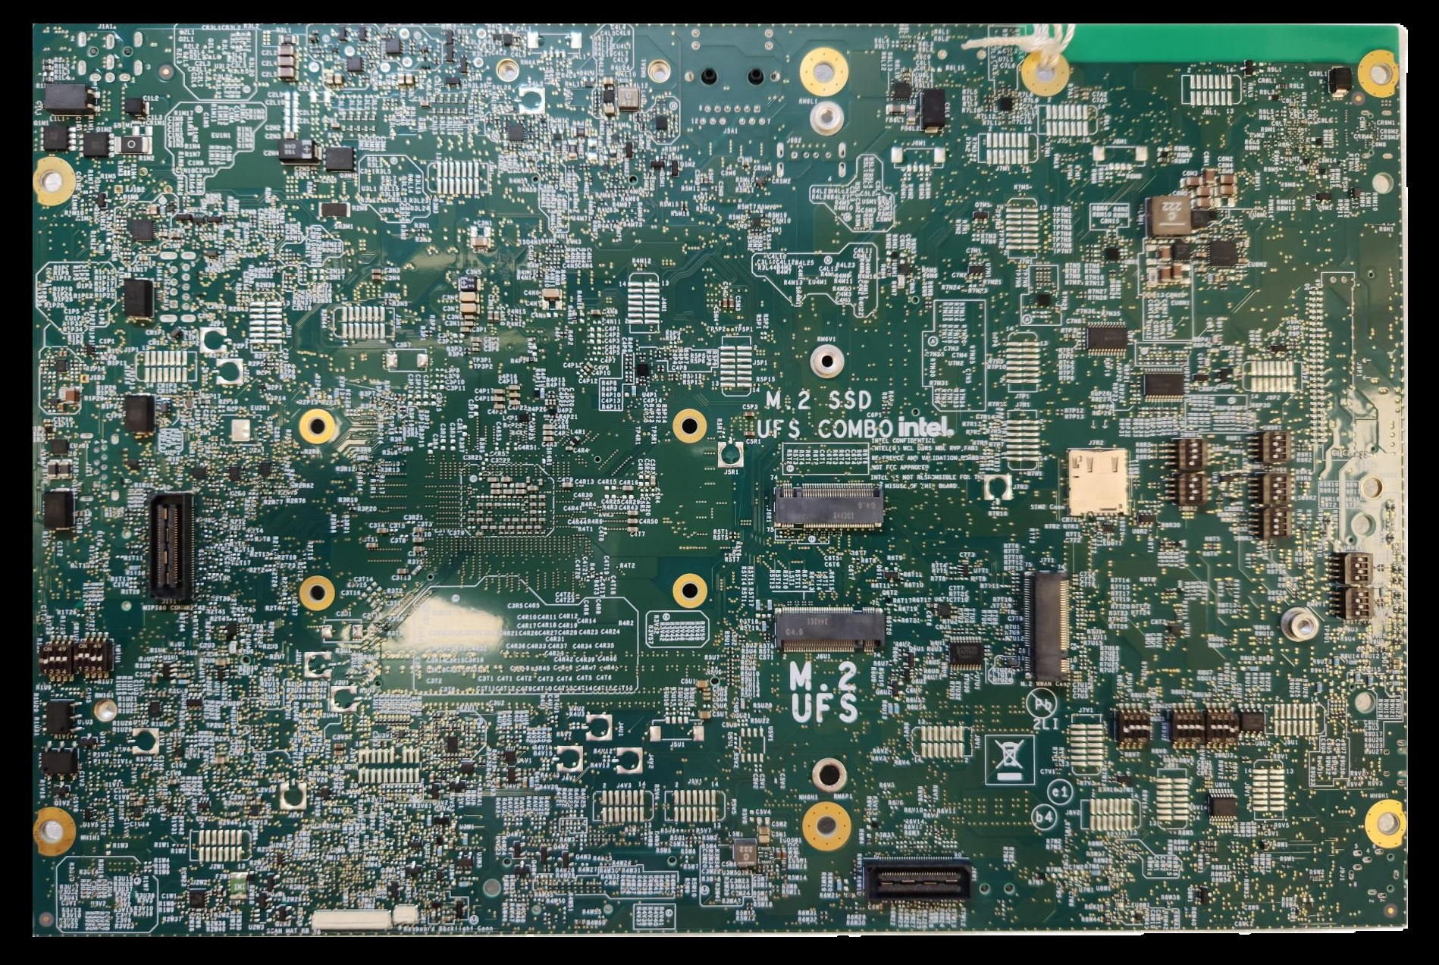
WCL DDR5 SODIMM T3 RVP-Board Layout –BOTTOM (Flipped)
Note:
Rework Option Config**
PnP HDR (J8L1)
PnP HDR (J7L1)
PnP HDR (J7M1)
PnP HDR (J3M1)
PnP HDR (J7N1)
PnP HDR (J2N1)
PnP HDR (J3N1)
PnP HDR (J4N1)
PnP HDR (J1P1)
PnP HDR (J5P1)
PnP HDR (J7P1)
PnP HDR (J9P2)
PD validation header** (J9P1)
PnP HDR (J7R1)
M.2 SSD Gen4 Con (J6R1)
SIM Slot (J7R2)
MIPI 60 Conn (J1T1)
M.2 UFS Discrete Con (J6U1)
M.2 WWAN** (J7T1)
Cortex Debug Conn** (J3V1)
PnP HDR (J9U1)
Cortex Debug Conn** (J3V1)
PnP HDR (J6V1)
PnP HDR (J7V1)
PnP HDR (J4V3)
PnP HDR (J5V1)
PnP HDR (J8V2)
PnP HDR (J8V1)
PnP HDR (J9V1)
PnP HDR (J2W1)
Sensor HDR (J6W1)
Board Size: 7.35x11inch
Layer: 12L (6 POR x 6 Val)
Scan Matrix Conn (J3W2)
KBD BKLT Conn (J3W1)

Slide 24
Memory
Lim, Kok Leng

Slide 25
POR Memory Configurations
RVP SKU | Config | Internal POR Transfer Rate (MT/s) | External POR Transfer Rate (MT/s) | Memory Device | Routing Topology | Supported System Memory |  | PCB Stack-Up / Routing Layer
 |  |  |  |  |  | Min | Max
RVP1 | DDR5 SODIMM 1DPC | 2R 7200 | 2R 6400 | CSODIMM/ SODIMM | Point to Point | 8GB | 64GB | T3/6L 2 Layers;
RVP2 | LPDDR5x Memory Down 2x32 | 2R 8000 | 2R 6800 | DDP QDP ODP 315 BGA | Point to Point | 4GB | 48GB | T3/6L 2 Layers.

Slide 26
DDR5 SODIMM Memory topology
DDR5 routing on WCL will be point-to-point routing for all the DDR5 signals.
DDR5 SODIMM Routing topology for WCL RVP1

Slide 27
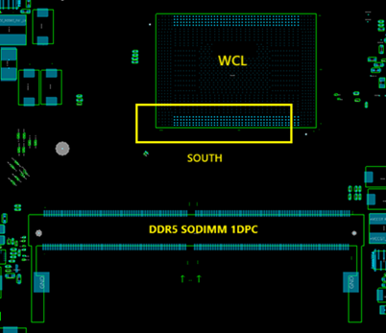
WCL DDR5 SODIMM Memory specification
WCL DDR5 memory details
Type | DDR5 SODIMM 1DPC
Topology | Non-Interleaved routing
Size | Boot kit support 16GB (1Rx8)
Placement | SODIMM slot x1
POR SPEED | 7200MT/s (iPOR), 6400MT/s (ePOR)
MPN | Micron - MTC8C1084S1VC64B (6400MT/s) Micron - MTC8C1084S1VC72B (7200MT/s)
WCL DDR5 SODIMM 1DPC for WCL RVP1
27

Slide 28
LPDDR5x Memory topology
The Address & command signals are routed with point-to-point topology with Data and Strobe signals in LP5x topology. The topology for x32 devices is illustrated in the figures below.
LPDDR5x with x32 devices routing on WCL RVP2

Slide 29
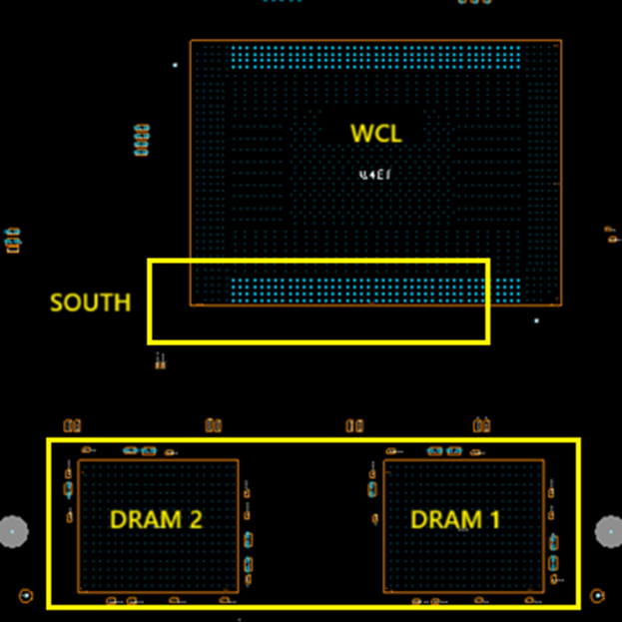
WCL LPDDR5x T3 Memory specification
WCL LP5x T3 memory details
Type | LPDDR5x 2x32, 2 DRAMs per channel
Topology | Non-Interleaved routing
Size | Total Boot kit support 16GB (8GB per DRAM)
Placement | Device down / Socketed
POR SPEED | 8000MT/s (iPOR), 6800MT/s (ePOR)
MPN | SK Hynix - H58G66BK8BX067 (8500MT/s)
WCL LPDDR5x 2x32 for WCL RVP2
29

Slide 30
WCL Memory devices supported with RVP
SKU | Memory | Size | Speed | MPN | IPN | MFG | Remark
RVP1 | DDR5 CSODIMM 1Rx8 | 16GB | 6400 | MTC8C1084S1VC64B | N26151-002 | Micron | Primary Part
RVP1 | DDR5 CSODIMM 1Rx16 | 8GB | 6400 | MTC4C10163S1VC64B | N25690-002 | Micron | Chrome Part
RVP1 | DDR5 CSODIMM 1Rx8 | 16GB | 7200 | MTC8C1084S1VC72B | N69278-001 | Micron | Spare Kit
RVP2 | LP5x 315b | 8GB | 8500 | H58G66BK8BX067 | N44159-001 | SK Hynix | Primary Part (Windows SD/SKT & Chrome SKT)
RVP2 | LP5x 315b | 4GB | 8500 | H58G56BK8BX068 | N23038-001 | SK Hynix | Chrome Part (MEM SD)
Above Memory Devices would be supported with each Board + Boot Kit demand received - any other devices needs to be procured by individual validation teams
Memory part may vary depending upon availability. For latest details refer to RVP SharePoint link
MIO link: https://intel.sharepoint.com/sites/PMOmemory/SitePages/Home.aspx

Slide 31
DISPLAY
Lim, Kok Leng

Slide 32
WCL RVP - Display Mapping
WCL support 3 pipes display with maximum 4Kp60 HDR output for both internal and external.
WCL RVP display mapping for different SKUs is as follow:
Interface | WCL DDR5 T3 RVP1 U-01 |  | WCL LP5x T3 RVP2 U-04
 | Option 1 (Default) | Option 2 (Rework) | Option 1 (Default) | Option 2 (Rework)
DDIA | eDP 1.5 Panel Conn | HDMI 2.1b 6G TMDS compatible connector with ALS | eDP 1.5 Panel Conn | NA
DDIB | HDMI 2.1b 6G TMDS compatible connector with ALS | NA | HDMI 2.1b 6G TMDS compatible connector with ALS | HDMI 2.1b 6G with CRLS
Topology | Manufacturer Part Number
HDMI 2.1 ALS (6G) | PI3HDX1204CZHEX

Slide 33
WCL RVP – eDP Panel supported list
WCL supported eDP Panel as below:
BOM# | Model#
Display: BOM53 | NV160WUM-L40
Display: BOM52 | MB40NW44-R0
Display: BOM51 | ATNA40HQ02-0
Display: BOM41 | M140NWFS R3
Display: BOM45 | LQ145N1JW01

Slide 34
WCL DDR5 SODIMM RVP1 Display Topology

Slide 35
WCL LP5x T3 RVP2 Display Topology

Slide 36
Modular TCSS Intro
CH, Manjunath

Slide 37
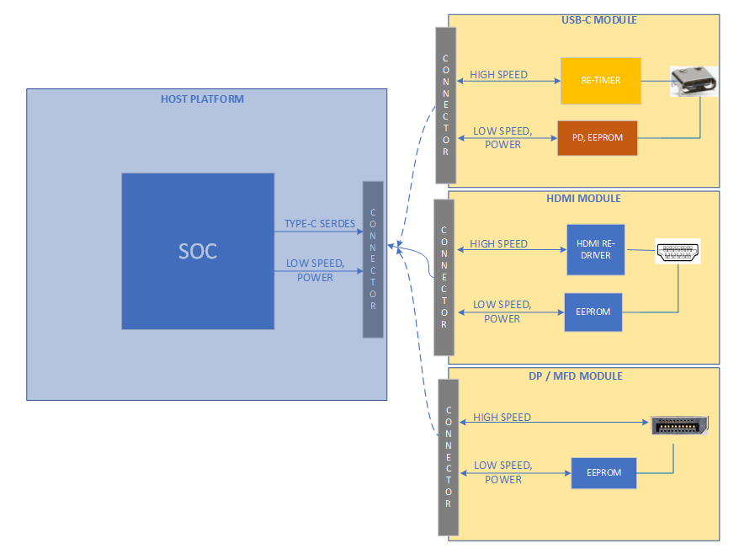
Modular TCSS on WCL RVP
Modular TCSS enable multiple Type-C configuration on Modular TCSS connector.
Instead of using multiple RVPs for Type-C validation, this new concept provide option to use the same RVP for different IO personality/connector enabling.
No rework (only SW settings change) or IFWI re-flashing on RVP needed for enabling the different modules.
WCL RVP supports Modular TCSS connector on which multiple IO modules [HDMI/Type-A/Type-C] can be plugged.
Modules designed based on the defined pinout to support all IO modules without rework.
Module routing is taken care to meet the PDG limit.
TCSS Modules are not hot pluggable. Module can be plugged/swapped in G3 only.
Note : Do not plug TCSS module on legacy M.2 SSD slot and vice versa

Slide 38
POR Module List for WCL RVP
Individual module block diagrams , schematics and layout files are available in goto/tcssmodule wiki link.
Each module can be identified using the TCSS Card# label provided on the module.
List includes the IPN for modules and PDC details provided in below table.
Module Name | PD Controller | Module No. | TA No.
TBT-40G HBR Retimer, TI-PD Module | TPS66993BAREPR | 103 | N38727-XXX
Type-A Redriver less Module | NA | 600 | N38705-XXX
TBT-40G Gothic Bridge Module | 99CZZT | 702 | N45935-XXX
TI PD, Retimerless USB3/DP2.1(HBR3) Type C | TPS66993BAREPR | 203 | N45940-XXX
ANX PD, Retimerless USB3/DP2.1(HBR3) Type C | ANX7407FN-AA-R | 204 | N46063-XXX
TI Redriver, USB3/DP2.1(HBR3) Type C | TPS66990G1BAREPR | 800 | N46067-XXX
ANX Redriver, USB3/DP2.1(HBR3) Type C | ANX7495QN-AA-R | 801 | N46084-XXX

Slide 39
Modular TCSS on WCL RVP
WCL support two Type C ports and TCSS Module support are listed below.
TCSS Modules are expected to connect as per SIV config.
Combination of TCSS Module with different PD vendors are not allowed.
TCP Ports | RVP SKUs
 | RVP1: WCL - T3 PCB - DDR5 SODIMM | RVP2: WCL - T3 PCB - LP5x MD
TCP0 Short Length | Config 1: M.2 Modular TCSS: USB-C Retimer Module. (Gothic Bridge Retimer) | Config 1: M.2 Modular TCSS: Third Party, Type C port - USB3/DP2.1 (HBR3) - Retimerless
 | Config 2: M.2 Modular TCSS: Type-A Con USB 3.2 Gen2 x1 10G w/o Redriver | Config 2: M.2 Modular TCSS - TBT 40G Single Re-Timer. (Single Retimer HBR)
 | Config 3: M.2 Modular TCSS - TBT 40G Single Re-Timer. (Single Retimer HBR) | Config 3: M.2 Modular TCSS: TBT 40G Single Re-Timer. (Gothic Bridge Retimer)
TCP1 Long Length | Motherboard Down Type C port - TBT 40G Single Re-Timer. (Single Retimer GBR Motherboard down) | Config 1: M.2 Modular TCSS: Third Party Redriver - USB3/DP 2.1 (HBR3) (Third party - Texas instrument and Analogix)
 |  | Config 2: M.2 Modular TCSS - TBT 40G Single Re-Timer. (Single Retimer HBR)
 |  | Config 3: M.2 Modular TCSS: TBT 40G Single Re-Timer. (Gothic Bridge Retimer)

Slide 40
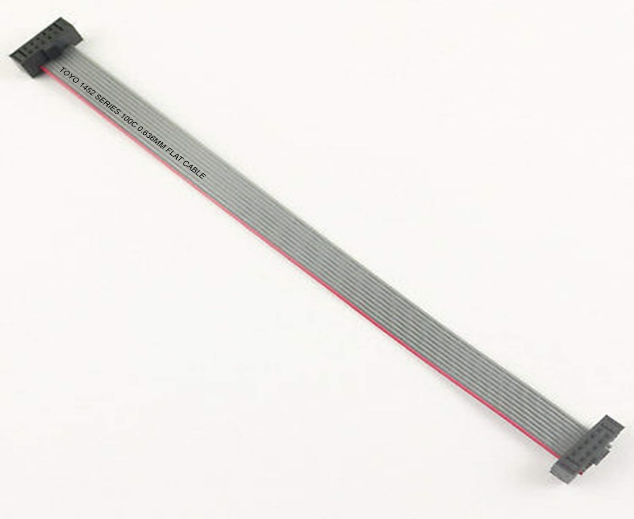
Low cost Modular TCSS on WCL RVP
WCL RVP2 support the low cost TCSS module from TI and Analogix Vendors.
WCL LP5x RVP with PB# N31367-001 requires a 2x4 cable to connect between two Type C Modular ports.
2x4 cable should be more than 200mm in length and the link to procure the cables are provided below.
Direction of connection of the cable is 1:1 with respect to Modular card header pinout.
Amazon link or RS link are the purchase link.

Slide 41
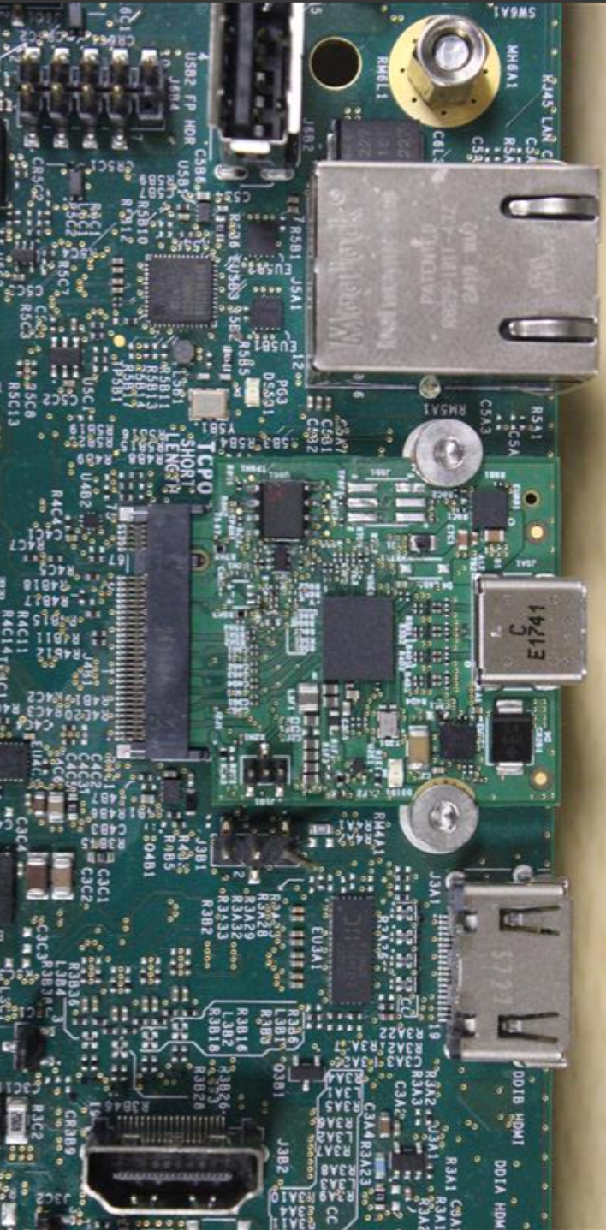
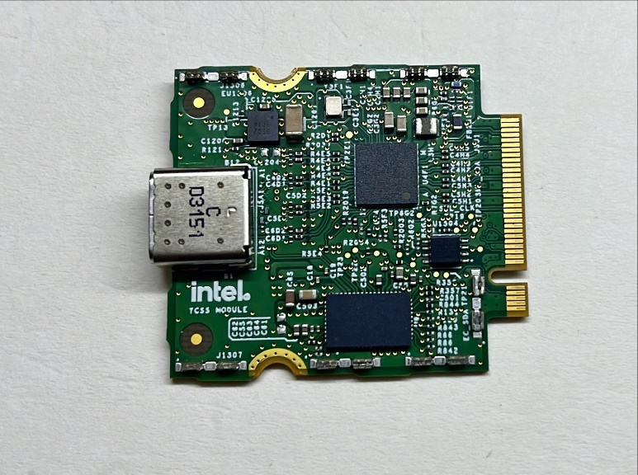
Modules Assembly on RVP
Modules are connected on TCSS Key-M connector (IPN# N23242-001) and recommended to screw the modules to avoid removal of module due to cables being plugged.

Slide 42
TCSS Modules – Programmable Devices
EEPROM , HBR/GBR retimer SPI Flash and PD controller on TCSS module need to be programmed.
EEPROM and HBR retimer flash is pre-programmed at factory. In case if user requires re-flashing, the procedure is provided in back up foils.[EEPROM] , [Retimer Flash]
If TBT modules with blank PD controller part (without PD FW being flashed) is plugged, it will avoid RVP boot sequence. Once PD controller is programmed, RVP can be booted to windows.
PD controller can be used using Aadvark I2C/SPI Host adapter and PD FW capsule update.
Bootloader WA FW to be flashed for TI PD controller if it is blank PD controller. This is one time flashing and after that normal BKC PD FW need to be flashed.
PD controller EC-PD I2C1 address need to be set from RVP. Switches provided on RVP to select the specific vendor I2C1 address. Please refer the switch setting in feature rework document (F-34) in portal.
PD controller detailed programming procedure document is available in sharepoint link

Slide 43
TBT Type-C Interface
CH, Manjunath

Slide 44
Type C Port mapping on WCL RVP
WCL SOC will support max 2 Type-C TBT ports. Below is the RVP wise Type C port mapping.
Gothic bridge is solder down on the RVP1 TCP1 and rest of the ports in all SKU’s are Modular.
Reworks (in the form of switch settings) are applicable only in case of usage of TI/ RTK/ANX based modular TCSS AICs across TCPx ports on RVP
Switch setting defaults to GBR for modular TCSS AIC (TBT40G module) in windows and defaults to Realtek vendor on Chrome.
No mix and match allowed between PD controller vendors on the platform.
TCP Port | RVP1 - WCL DDR5 | RVP2 - WCL LP5x
 | Default | Default
TCP0 | Modular TCSS card | Modular TCSS card
TCP1 | Single GBR (On-board Type-C) | Modular TCSS card

Slide 45
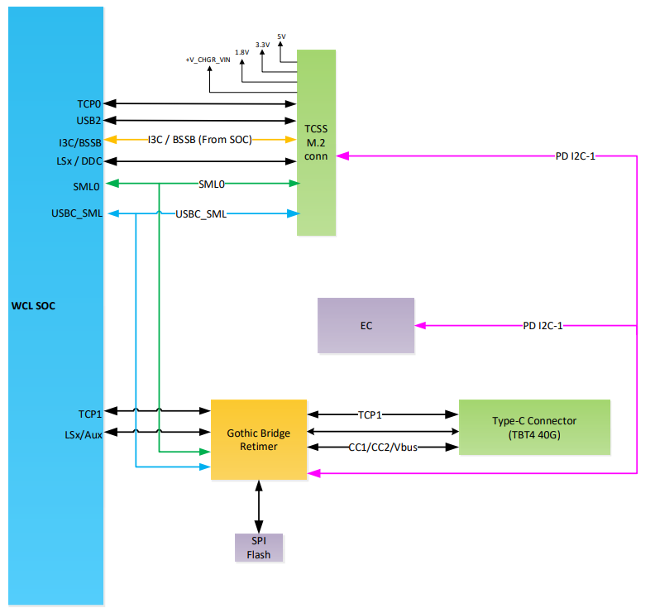
WCL DDR5 SODIMM Type-C block diagram

Slide 46
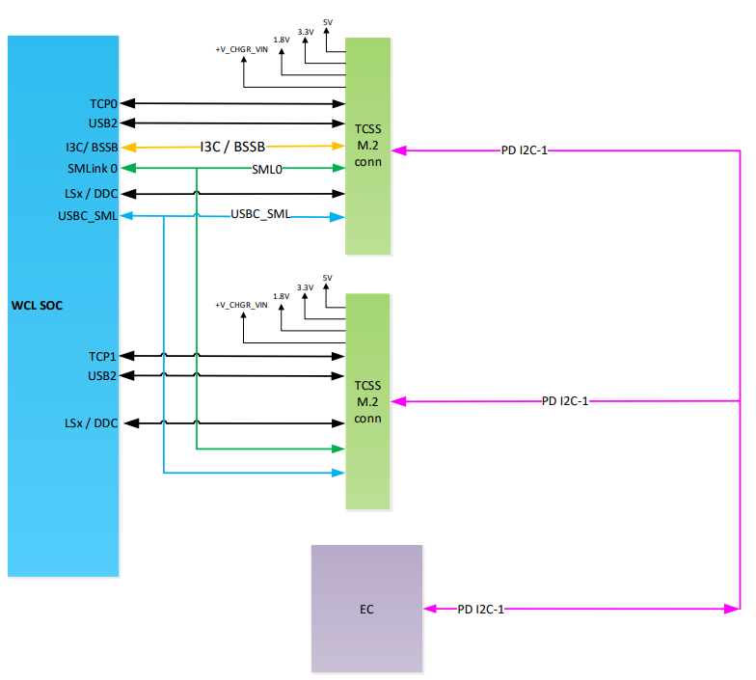
WCL LP5x Type-C block diagram

Slide 47
DnX Support
DnX –Download and execute is a feature that allows updating the system FW from a host through USB2 port.
DnX is supported on TCP0 port of WCL RVPs.
DnX could be triggered
- By pressing VOL_UP and VOL_DOWN button together during early boot
Using DnX jumper on board( this is validation option only).
DnX LED indicates if the FW download / execution is in progress, once DnX is triggered during bootup.

Slide 48
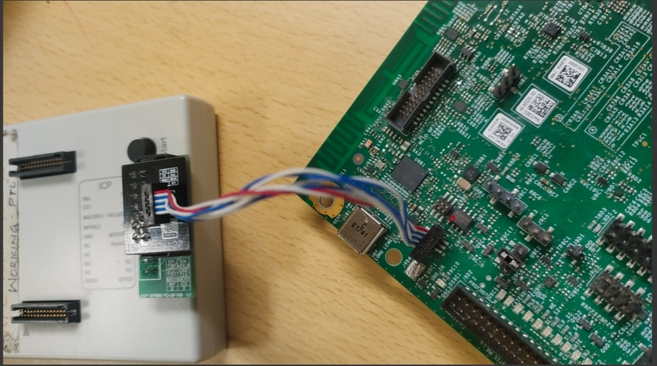
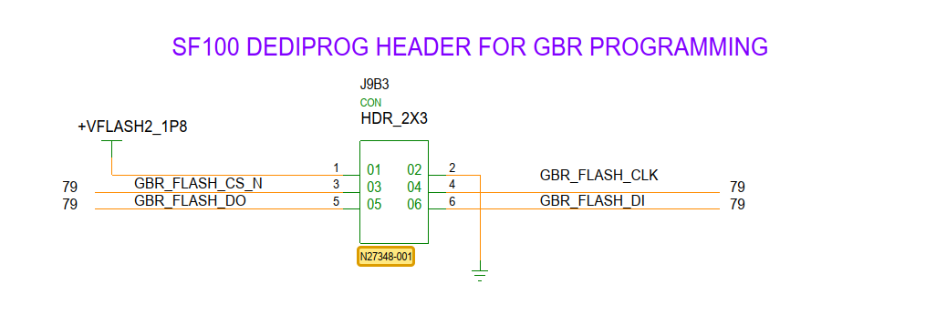
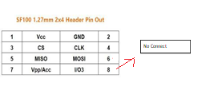
GBR Flash Programing
Dediprog SF100 2x3 header with 1.27mm pitch has been provided for SPI Flash programming.
Need SF100 along with Universal Adapter board and cable for programming
https://www.dediprog.com/product/ISP-ADP-127
Cable has 2x4 header (Ref Des: J9B3) and Last two pins are NC in it. Hence leave last two pins unconnected and connect just 6 pins as below.
Flash to be programmed in RVP powered OFF state – G3 state, Dediprog will be Master and will supply above1.8V for GBR Flash
WCL DDR5 RVP1 - Image
Using Dediprog SF600/SF100 with crocodile clips is not recommended

Slide 49
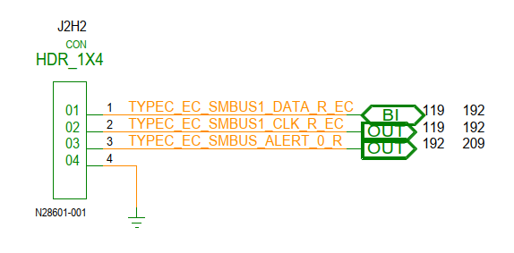
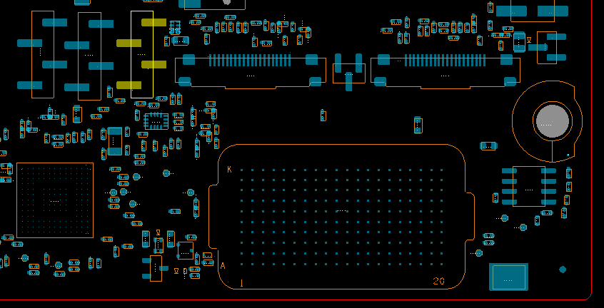
PD controller programming
PD controller can be programmed in three ways,
Through 1x3 header on RVP using Aardvark programmer
Capsule update via BIOS
CC line programming (applicable only for Realtek PD AIC on Chrome SKUs)
Programming guidelines:
Please refer below link for PD controller programming guide,
PD FW flashing guide
TOP (WCL LP5x T3 RVP)

Slide 50
HSIO mapping
Li, Kok Wai Ryan

Slide 51
WCL RVP – PCIE port mapping
 |  |  | DDR5 SODIMM T3 |  |  | LP5x T3
 |  |  | RVP-1 (default) | RVP-1 (rework) | RVP-1 (rework) | RVP-2 (default) | RVP-2 (rework)
PCIe Gen4 | PXPA | P0-3 | M.2 Gen4 SSD Key-M (NIST) (J6R1) | - | - | M.2 Gen4 SSD Key-M (NIST) (J7E1) | x4 Gen4 DT CEM #2 (J8C3)
 | PXPC | P4 | x4 Gen4 DT CEM #1 (J6C3) | M.2 WLAN Key-E (J2G2) | - | x4 Gen3 DT CEM #1 (J8C1) | M.2 WLAN Key-E (J2G2)
 |  | P5 | Gbe LAN Jacksonville (J5A1) | x4 Gen4 DT CEM #1 (J6C3) | M.2 WWAN Key-B (non-POR) (J7T1) | Gbe LAN Jacksonville (J5A1) | x4 Gen3 DT CEM #1 (J8C1)
TOP PLACEMENT
BOTTOM PLACEMENT

Slide 52
WCL RVP – SRC CLKOUT & CLKREQ port mapping
Note: WCL’s CLK REQ & SOC CLK is 1:1 mapping only. |  | DDR5 SODIMM T3 |  | LP5x T3
 |  | RVP-1 (default) | Refdes | RVP-2 (default) | Refdes
CLKREQ:CLKOUT | CLKREQ_0: SOCCLK_0 | M.2 WLAN Key-E | J2G2 | M.2 WLAN Key-E | J2G2
 | CLKREQ_1: SOCCLK_1 | TP | - | TP | -
 | CLKREQ_2: SOCCLK_2 | x2 Gen4 DT CEM #1 | J6C3 | x2 Gen3 DT CEM #1 | J8C1
 | CLKREQ_3: SOCCLK_3 | M.2 Gen4 SSD Key-M (NIST) | J6R1 | M.2 Gen4 SSD Key-M (NIST) | J7E1
 | CLKREQ_4: SOCCLK_4 | M.2 WWAN Key-B (non-POR) | J7T1 | x4 Gen4 DT CEM #2 | J8C3
 | CLKREQ_5: SOCCLK_5 | Gbe LAN Jacksonville | J5A1 | Gbe LAN Jacksonville | J5A1
TOP PLACEMENT
BOTTOM PLACEMENT

Slide 53
WCL RVP – USB2.0 & USB3.2 port mapping
WCL supports 8 USB2.0 ports and 2 USB3.2 Gen 2x1 ports
 |  |  | DDR5 SODIMM T3 |  |  |  | LP5x T3
 |  |  | RVP-1 (default) | Refdes | RVP-1 (rework) | Refdes | RVP-2 (default) | Refdes | RVP-2 (rework) | Refdes
USB3.2 Gen2x1 (10G) Bifurcation |  | P1 | USB3.2 gen2 TAP-1 (vertical) | J1C3 | - | - | USB3.2 gen2 TAP-2 with RDRVR | J1E1 | - | -
 |  | P2 | USB3.2 gen2 TAP-2 with RDRVR | J1E1 | - | - | USB3.2 gen2 TAP-1 (vertical) | J1C3 | - | -
USB2.0 Bifurcation |  | P1 | TCP-0 (M.2 MODULAR TCSS AIC-1) | J4B1 | USB2.0 TAP-1 PPV (vertical) | J6B2 | TCP-0 (M.2 MODULAR TCSS AIC-1) | J4B1 | USB2.0 TAP-1 PPV (vertical) | J6B2
 |  | P2 | TCP-1 (ONBOARD TBT PORT-1) | J9B1 | - | - | TCP-1 (M.2 MODULAR TCSS AIC-2) | J8B1 | - | -
 |  | P3 | USB3.2 gen2 TAP-1 | J1C3 | - | - | USB3.2 gen2 TAP-1 | J1C3 | - | -
 |  | P4 | USB3.2 gen2 TAP-2 with RDRVR | J1E1 | - | - | USB3.2 gen2 TAP-2 with RDRVR | J1E1 | - | -
 |  | P5 | 2x5 HDR #1 | J6B4 | M.2 WWAN Key-B | J1T1 | 2x5 HDR #1 | J6B4 | - | -
 |  | P6 |  |  | USB2.0 Camera | J7A2 |  |  | USB2.0 Camera | J7A2
 |  | P7 | FPS | J1F1 | 2x5 HDR #2 (PPV) | J1D1 | FPS | J1F1 | 2x5 HDR #2 (PPV) | J1D1
 |  | P8 | M.2 WLAN Key-E | J2G2 |  |  | M.2 WLAN Key-E | J2G2
TOP PLACEMENT
BOTTOM PLACEMENT

Slide 54
STORAGE
Li, Kok Wai Ryan

Slide 55
WCL DDR5 SODIMM RVP – Storage support

Slide 56
WCL LP5x RVP – Storage support

Slide 57
UFS
Li, Kok Wai Ryan

Slide 58
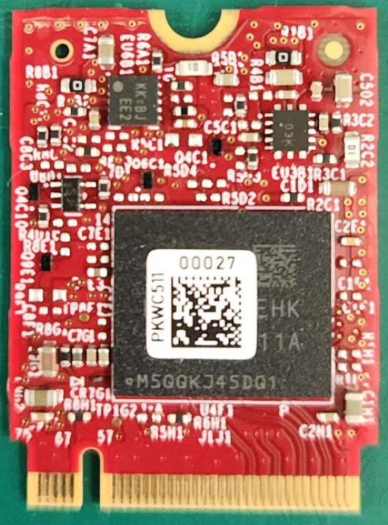
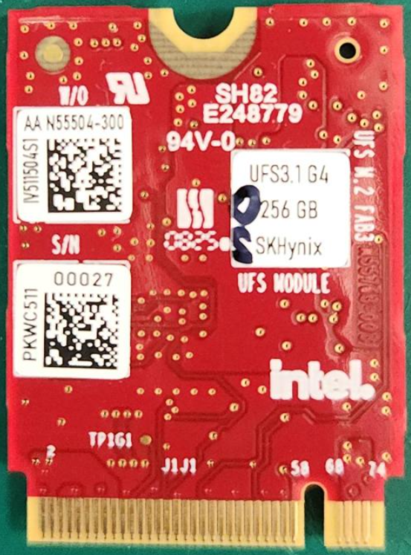
WCL RVP – UFS Support
WCL RVP supports UFS3.1 interface on RVP1 and RVP2 SKUs.
WCL RVP1 DDR5 SKU support UFS interface in Combo mode with M.2 SSD Gen4 as rework option. Combo mode not support on RVP2.
The RVP supports only M.2 UFS3.1 Fab3 AIC. No other AICs are supported.
The M.2 UFS3.1 Fab3 AIC uses 256GB UFS3.1 device as below:
SK Hynix (MPN: HN8T15DEHKX075)
Samsung (MPN: KLUEG8UHGC-B0E1)
WIKI for UFS provisioning: https://wiki.ith.intel.com/display/DebugEncyclopedia/UFS+Card+Provisioning
WCL RVP will no longer support Littlemount AIC.
T3 DDR5 RVP1 | T3 LP5x RVP2
M.2 UFS3.1 Fab3 AIC | M.2 UFS3.1 Fab3 AIC
Notes:
SKU strategy similar like LNL –One SKU C-PHY rest all are D-PHY

Slide 59
Connectivity
Jadhav, Aniket

Slide 60
Overview- Connectivity
The WCL chipset supports Integrated Connectivity CNVio and discrete WLAN+BT
The other connectivity options are Gbe LAN and WWAN (non-POR).
The below table gives the list of modules supported on WCL RVP as connectivity solutions.
Interface Name | Module Name | Remarks
Integrated CNVIo CNVi DPHY TX/RX, Step (Wi-Fi) BRI/RGI (BT) | Spider Peak 2 Garfield Peak 2 | M.2 Key E Socket
Discrete WLAN+BT PCIe TX/RX (Wi-Fi) USB2.0 (BT) | Gale Peak 2 | M.2 Key E Socket
WWAN (Non-POR) | Maple spring FM350-GL (5G Module) | M.2 Key B Socket
Gbe LAN | Jackson Ville (Device down) | RJ-45 Jack

Slide 61
Overview- Connectivity
RVP1
RVP2

Slide 62
AUDIO
Jadhav, Aniket

Slide 63
WCL RVP- Audio block diagram

Slide 64
WCL RVP Audio overview
WCL RVP enables value system with single-chip audio solution with on board codec ALC722-CG [SDCA 0.8] compliant soundwire based codec default configured using SNDW3 multilane port across all the RVP sku’s.
RVP supports different audio codecs validation through add-in-card solution. Realtek AIOC GEN6 is the POR AIC for WCL & Cirrus AIC v3 will support delta validation configuration along with existing Realtek AIOC GEN3 to support HDA [ALC245] validation.
Notes:
Reference :
Gen 6 Audio Add-In-Card - Reference Validation Platform Design Wiki - Intel Enterprise Wiki
Cirrus AIOC v3 - Reference Validation Platform Design Wiki - Intel Enterprise Wiki
Gen3 Audio Add-In-Card - Reference Validation Platform Design Wiki - Intel Enterprise Wiki
Gen4 Audio Add-In-Card - Reference Validation Platform Design Wiki - Intel Enterprise Wiki

Slide 65
Audio links supported in WCL RVP sku’s
Audio links include:
1x HD-A link for HD-A compatible peripherals
4 Sound wire ports for platform peripherals
Two dual-channel PDM directly attached microphone interfaces
3x I2S ports for platform peripherals
Audio Interface | Default Configuration | Rework option | RVP-1 : WCL DDR5 T3 | RVP-2 : WCL LP5x T3 | Remarks
H-DA | JA – HDA/I2S0 Header | - | ✓ | ✓ | -
SNDW0 | - | - | ✓ | ✓ | SNDW0 is muxed with SNDW3 multilane
SNDW1 | JD - SNDW/DMIC Header | - | ✓ | ✓ | -
SNDW2 | JD - SNDW/DMIC Header | - | ✓ | ✓ | -
SNDW3 Multilane | On-board ALC722 Codec | JE – SNDW/I2S1 Header | ✓ | ✓ | -
DMIC0 | JD - SNDW/DMIC Header | - | ✓ | ✓ | Only BIOS change
DMIC1 | JD - SNDW/DMIC Header | - | ✓ | ✓ | Only BIOS change
I2S0 | JA – HDA/I2S0 Header | - | ✓ | ✓ | -
I2S1 | - | JE – SNDW/I2S1 Header | ✓ | ✓ | -
I2S2 | - | M.2 WLAN Connector | ✓ | ✓ | -

Slide 66
Audio Privacy Microphone Protection
WCL RVP uses SoC pins MIC_MUTE and MIC_MUTE_LED to support microphone privacy protection. 3-pin jumper is designed to control the MIC privacy operation. However, by default HW controlled mic privacy support is disabled in the BIOS, user needs to select the BIOS knobs to test mic mute feature via jumper
HSD : 16026832935 - Set default to “No Microphone Privacy Support” for Microphone Privacy Settings
Notes:
Reference : ACE3.x Integration HAS (intel.com)

Slide 67
Audio reference links
RVP HAS link :
Gen 6 Audio Add-In-Card - Reference Validation Platform Design Wiki - Intel Enterprise Wiki
Cirrus AIOC v3 - Reference Validation Platform Design Wiki - Intel Enterprise Wiki
Gen3 Audio Add-In-Card - Reference Validation Platform Design Wiki - Intel Enterprise Wiki
Gen4 Audio Add-In-Card - Reference Validation Platform Design Wiki - Intel Enterprise Wiki
https://docs.intel.com/documents/iparch/ace/ACE%20IP/3.x/Integration%20Specs/WCL/WCL_ACE3.x_Integration_HAS.html
HSD : 16026832935 - Set default to “No Microphone Privacy Support” for Microphone Privacy Settings

Slide 68
SPI Flash & TPM
Jadhav, Aniket

Slide 69
SPI Flash Topology & Feature
POR frequency for SPI flash: 100MHz
SPI Flash part :
Windows : SPI NOR Flash 512Mbit/64MB RPMC (Macronix MPN –MX77U51250FZ4I42), WSON-8, 1.8V
Chrome : SPI NOR Flash 256Mbit/32MB DTR (Winbond MPN - W25Q256JWEIM), WSON-8, 1.8V
Dual Flash Topology as 1x 64MB (default) + 1x64MB (rework) option will be provided only in DDR5-RVP1.
In DDR5-RVP1 G3 topology supported by default. SAF and MAF can be enabled with reworks.
In LP5x-RVP2 MAF topology supported by default. SAF and G3 can be enabled with rework(SW/Jumper setting).
Reworks for enabling MAF to SAF mode and G3 to MAF/SAF mode are minimized wrt previous platforms.
dTPM in SAF mode is supported only in DDR5-RVP1 SKU via TPM header.
Notes:
TTK3 version to be used -> have this info backup

Slide 70
SoC SPI0 Topology in WCL DDR5 RVP1 SKU

Slide 71
SoC SPI0 Topology in WCL LP5x T3 RVP2 SKU

Slide 72
Sensors
K S, Vachana

Slide 73
Block Diagram – Sensors and Sensor AIC
WCL
Sensor Header
WCL
ISH I2C0/I3C0
ISH I2C1/I3C1
ISH I2C2
ISH UART0
ISH UART1
Used as GPIOs
ISH SPI
ISH GPIOs
(0-7)
ISH GPIO4
USB
Camera
SAR_NIRQ
ISH GPIO11
M.2 WWAN
(non-POR)
Note:
Solid line indicate default support on the board. Dotted lines indicate the need for rework.
ISH_UART1 is used as GPIOs, ISH_UART0 is rework option to Sensor HDR

Slide 74
ISH interface mapping
BOM1 and BOM2 Sensor AICs are used for validation
ISH5.8
BOM1 |  |  | BOM2
Bosch BMI323 (I3C) | ISH_I2C0 | ISH_GP_5 | ST LSM6DSV16 (I3C) | ISH_I3C1 | IBI
Memsic MMC5603NJ (I3C) | ISH_I2C0 | NA | AKM AK9919C (I3C) | ISH_I3C1 | NA
Bosch BMI323 (I3C) | ISH_I2C0 | NA | ST LSM6DSV16 (I3C) | ISH_I3C1 | NA
Bosch BMA422 | ISH_I2C0 | ISH_GP_6 | ST LIS2DW12 | ISH_I2C0 | ISH_GP_6
 |  |  | ST LSM6DSV32 (I3C) | ISH_I3C1 | IBI
 |  |  | ST LPS22DF | ISH_I2C0 | NA
Rohm BU52072GWZ | NA | ISH_GP_3 ISH_GP_4 | Rohm BU52072GWZ | NA | ISH_GP_3 ISH_GP_4
VCNL4030 | ISH_I2C0 | ISH_GP_2
VCNL4030 | ISH_I2C0 | ISH_GP_2 | STMicro VD6283 | ISH_I2C0 | NA
 |  |  | STMicro VD6283 | ISH_I2C0 | NA
Semtech Sx9331 | ISH_I2C0 | SAR_NIRQ | Semtech Sx9331 | ISH_I2C0 | SAR_NIRQ
STM VL53L7 | ISH_I2C2 | ISH_GP_1
 |  |  | Infineon BGT60TR13C | ISH_SPI0 | ISH_GP_0 ISH_GP_2 ISH_GP_7
Bus | Device Mapping
ISH SPI | Sensor Header
ISH GPIOs | Sensor Header
Bus | Device Mapping
ISH I2C0 / I3C0 | Sensor Header, TTK3 Header
ISH I2C1 / I3C1 | Sensor Header , SV Header
ISH I2C2 | Sensor Header , SV Header
Bus | Device Mapping
ISH UART0 | Sensor Header

Slide 75
Block Diagram – Fingerprint Sensor
WCL
Goodix Fingerprint sensor Connector
( Mounted on Top side)
IPN: G90173-001
USB 2.0 P7
Note:
Only USB2.0 based sensor is POR for WCL for FPS connectivity.
The connector pinout only USB2.0.

Slide 76
Block Diagram – WCL RVP Touch Panel & Touch Pad
WCL
THC/LPSS I2C4
Touch Panel-1 Connector (Default)
THC0 SPI1
THC1 SPI2
Touch Panel-2 Connector
THC/LPSS I2C5
LPSS I2C3
Touch Pad Connector
Note:
Solid line indicate default support on the board. Dotted lines indicate the need for rework.
Rework details will be provided in feature enabling documents.
THC I2C is provided as default for touch panel-1 . THC I2C is POR for touchpad

Slide 77
LPSS & LSIO
K S, Vachana

Slide 78
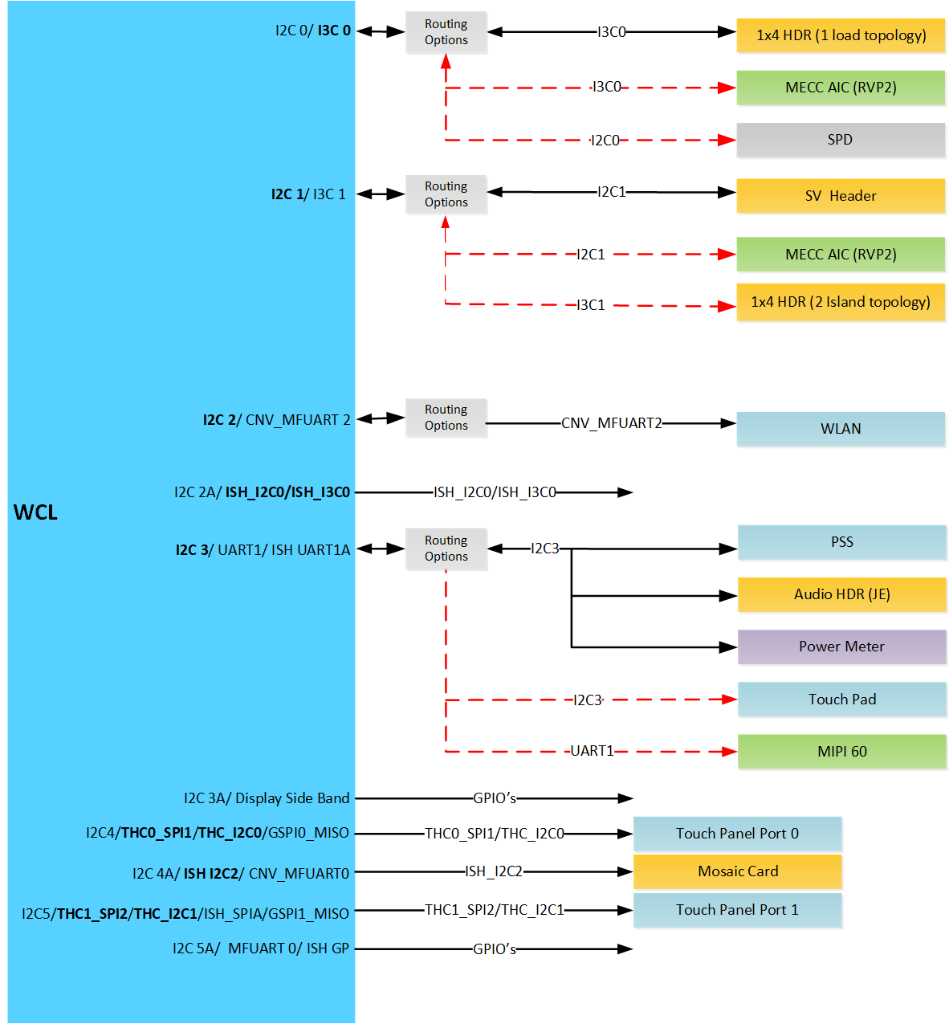
WCL RVP : LPSS I2C Block Diagram

Slide 79
WCL RVP : LPSS I2C Devices Mapping
INTERFACE | Devices in LP5x T3 RVP | Devices in DDR5 SODIMM RVP
LPSS I2C0/I3C0 | 1x4 HDR (as I3C0) | 1x4 HDR (as I3C0)
 | Memory SPD (as I2C0) | Memory SPD (as I2C0)
 | MECC AIC (as I3C0) | -
 | TTK3 for chrome rework as I2C0 | TTK3 for chrome as I2C0
LPSS I2C1/I3C1 | SV HDR | SV HDR
 | 1x4 HDR (as I3C1) | 1x4 HDR (as I3C1)
 | MECC AIC (as I2C1) | -
LPSS I2C2 | M.2 WLAN (as CNV_MFUART2) | M.2 WLAN (as CNV_MFUART2)
LPSS I2C3 | PSS | PSS
 | Audio HDR | Audio HDR
 | Power Meter | Power Meter
 | MIPI 60 | MIPI 60
 | Touch Pad | Touch Pad
LPSS I2C4 | Used as THC0_SPI1/THC_I2C0
LPSS I2C5 | Used as THC1_SPI2/THC_I2C1

Slide 80
WCL RVP : LSIO Device Address details
Device | Speed | 7 Bit address Set | 7 Bit Address Options | I2C IO Voltage
Touch Pad | 400KHz | 0x2C | 0x2C | 3.3V
Touch Panel-1 | 400KHz/ 1MHz | 0x16 | 0x16 | 1.8V
Touch Panel-2 | 400KHz/ 1MHz | 0x2C | 0x2C | 1.8V
PSS | 400KHz | 0x6E | 0X68 or 0x6A or 0X6C or 0X6E | 1.8V
Power meter Chip#1 | 100KHz/ 400KHz/ 1MHz ( FM+) | 0x18 | Configurable through resistor | 1.8V
Power meter Chip#2 | 100KHz/ 400KHz/ 1MHz ( FM+) | 0x1E | Configurable through resistor | 1.8V
Power meter Chip#3 | 100KHz/ 400KHz/ 1MHz ( FM+) | 0x11 | Configurable through resistor | 1.8V
Power meter Chip#4 | 100KHz/ 400KHz/1MHz ( FM+) | 0x15 | Configurable through resistor | 1.8V
Power meter Chip#5 | 100KHz/ 400KHz/1MHz ( FM+) | 0x19 | Configurable through resistor | 1.8V
Power meter Chip#6 | 100KHz/ 400KHz/1MHz ( FM+) | 0x14 | Configurable through resistor | 1.8V
Power meter Chip#7 | 100KHz/ 400KHz/1MHz ( FM+) | 0x17 | Configurable through resistor | 1.8V
Power meter Chip#8 | 100KHz/ 400KHz/1MHz ( FM+) | 0x16 | Configurable through resistor | 1.8V
Power meter Chip#9 in RVP2 | 100KHz/ 400KHz/1MHz ( FM+) | 0x13 | Configurable through resistor | 1.8V
Power meter Chip#10 in RVP2 | 100KHz/ 400KHz/1MHz ( FM+) | 0x1B | Configurable through resistor | 1.8V
High accuracy Power meter Chip#1 | 100KHz/ 400KHz/1MHz ( FM+) | 0x12 | Configurable through resistor | 1.8V
High accuracy Power meter Chip#2 | 100KHz/ 400KHz/1MHz ( FM+) | 0x1D | Configurable through resistor | 1.8V
High accuracy Power meter Chip#3 | 100KHz/ 400KHz/1MHz ( FM+) | 0X1A | Configurable through resistor | 1.8V
CONNECTIVITY - GBIT LAN - JACKSONVILLE LAN PHY CHIP |  | 0xC8 (Read) , 0xC7 (Write) |  | 3.3V
FRU EEPROM | 100KHz/400KHz | 0xAD(Read), 0xAC (Write) | Configurable through resistor | 3.3V

Slide 81
WCL RVP: SMBUS, SMLINK, MLINK Block Diagram

Slide 82
WCL RVP LSIO : SMBUS, SMLINK, MLINK Mapping
INTERFACE | RVP2:Devices in LP5x T3 RVP | RVP1:Devices in DDR5 SODIMM RVP
SMBUS (ALERT line is used as GPIO) | PCIE X4 Slot | PCIE X4 Slot
 | FRU EEPROM | FRU EEPROM
 | ESPI bus Header | ESPI bus Header
 | SPD EEPROM | DDR5 SODIMM
 | PM Side Band Header | PM Side Band Header
 | CPU/PCH Merged MIPI 60 Connector | CPU/PCH Merged MIPI 60 Connector
 | TTK3 Header | TTK3 Header
 | - | M.2 WWAN
SMLINK0 (ALERT line is used as GPIO) | TBT retimer Chip#0 ( for TCP-0 SV Validation) & 1x3 Header | TBT retimer Chip#0 ( for TCP-0 SV Validation) & 1x3 Header
 | TBT retimer Chip#1 ( for TCP-1 SV Validation) | TBT retimer Chip#1 ( for TCP-1 SV Validation)
 | 1x3 Header | 1x3 Header
 | Jacksonville | Jacksonville
 | PCIE x4 Slot | PCIE x4 Slot
SMLINK0B (default used as GPIOs) | Sensor Header (as ISH SPI/ISH UART) | Sensor Header (as ISH SPI/ISH UART)
 | TTK3 Header | -
SMLINK1 (ALERT line is used as GPIO) | Modular TCSS AIC CONN0 | Modular TCSS AIC CONN0
 | Modular TCSS AIC CONN1 | On-board GBR
 | PM SIDEBAND HEADER | PM SIDEBAND HEADER
MLINK | M.2 KEY-E CONNECTOR - WLAN/BT | M.2 KEY-E CONNECTOR - WLAN/BT
 | MLink HEADER | MLink HEADER

Slide 83
WCL RVP LSIO : SPI ,THC, eSPI Mapping and
LPSS : UART Mapping
INTERFACE | Devices in LP5x T3 RVP | Devices in DDR5 SODIMM RVP
SPI-0 FLASH | 100MHz 64MB Flash | 100MHz 64MB Flash
 | TPM Header | TPM Header
 | 32 MB SPI NOR for Chrome | 100MHz 64MB Flash
 | TTK3 Header | TTK3 Header
 | MECC AIC Connector
THC-0 SPI-1 muxed with GSPI-0 | Touch Panel 1(as THC I2C0) | Touch Panel 1(as THC I2C0)
 | Touch Panel 1(as THC0 SPI1) | Touch Panel 1(as THC0 SPI1)
THC-1 SPI-2 muxed with GSPI1/THC_I2C1 | Touch Panel 2 (as THC_I2C1) | Touch Panel 2 (as THC_I2C1)
 | Touch Pad (as THC_I2C1) | Touch Pad (as THC_I2C1)
eSPI | EC | EC
 | eSPI Bus Header | eSPI Bus Header
 | MECC AIC Connector
INTERFACE | Devices in LP5x T3 RVP | Devices in DDR5 SODIMM RVP
UART-0 | USB to Dual UART (only RX and TX lines) | USB to Dual UART (only RX and TX lines)
 | TTK3 Header | TTK3 Header
UART-1 | Default Used as I2C3 Track PAD/ Audio/PSS/ Power meter/TTK3
UART-2 | Default used as CNVi BRI/RGI Signals to M.2 KEY-E CONNECTOR - WLAN/BT

Slide 84
Embedded Controller
K S, Vachana

Slide 85
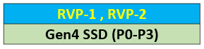
Embedded controller - Overview
WCL RVP will support MEC1723NB0-I/SZ (144-pin WFBGA package) Microchip EC onboard.
ESPI mode of operation. LPC mode is not supported by WCL SOC.
200 pin MECC AIC Connector (MPN : 84535-191LF, AFCI) is provided in WCL –U10 (RVP2 LP5x T3 MECC SKU) to support EC AIC from different vendors.
MECC connector is also supported in RVP2 LP5x T3 Chrome boards (U-06 , U07). Other than these, no other SKU of WCL RVP support MECC connector.
The Key functionalities of EC on the platform are listed below,
Thermal Management like CPU Fan control, Chassis Fan control, PECI, DIMM temperature etc.
PECI over eSPI is default. Physical PECI pin from EC is a rework option.
Platform Power management like Power sequencing and Sx entry/exits.
Modern Standby requirements are implemented inside EC.
Handles the Board-ID, Fab-ID, BOM SKU-ID, messages to the BIOS.
RVP supports all three i.e., MAF, SAF, G3 Flash configuration.
In addition to MECC AIC support, 2x14 pin eSPI header is also be supported over rework option.
Separate PMR resistors are added for 1.8V and 3.3V rails going to EC.
PS2 KB connector is unstuffed by default in all the RVP SKUs. (PS2 mouse is not supported in any of the SKUs)
NIST-193 Firmware Recovery will be supported in WCL on Gen4 SSD

Slide 86
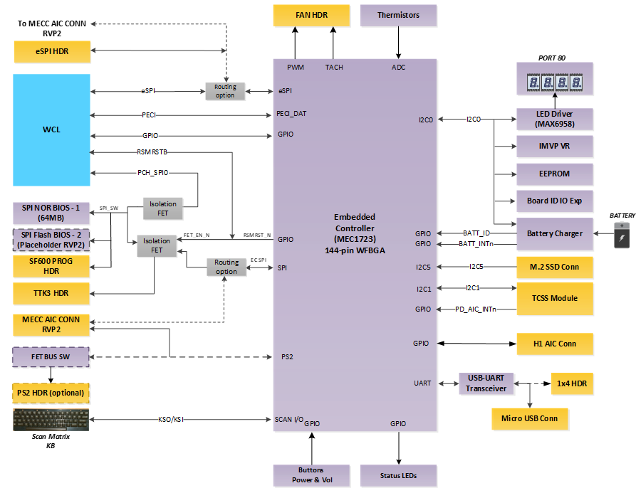
Embedded controller - Block diagram

Slide 87
Chrome Support
CH, Manjunath

Slide 88
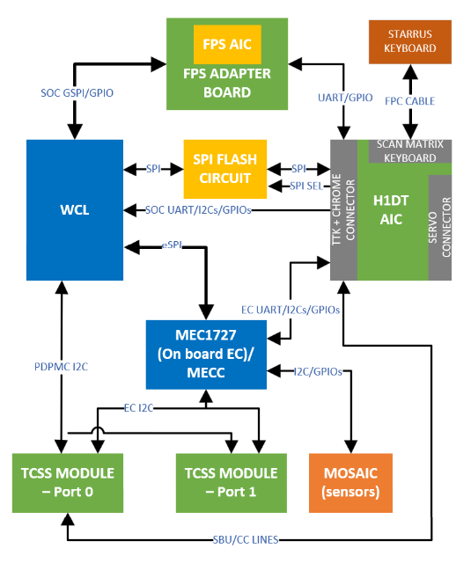
WCL RVP Chrome Strategy
WCL RVP supports Chrome requirements through Chrome RVP BOM SKU.
BOM SKU will be supported in LP5 and DDR5 SKUs.
Chrome supports three EC controllers, Microchip, ITE and Nuvoton.
WCL DDR5 support Onboard Microchip EC.
WCL LP5x support MECC based EC card with ITE and Nuvoton controllers.
DT AIC based on H1D3C chip will be plugged on TTK3/H1 AIC connector.
WCL DT AIC is different from PTL DT AIC with recent learning and KB feature.
WCL DT AIC follow the BOM TA: M82176-202
Will have both micro servo and CCD based debug support (over Type C Port-0) .
Type C subsystem implementation is through TCSS modules.
Realtek PDC based 40G re-timer TCSS module is a POR and supported in both ports.
TI low-cost solution module are POR, and modules are connected as per SIV config.
All the TCSS Modules are SPR – 20V supported in WCL.
ISH and EC I2C based sensor support.
Chrome FPS support through adapter board.

Slide 89
WCL RVP - Chrome
Chrome Audio support
Default Support is SNDW (ALC721) and HDA (ALC256) through Add on card.
I2S support through AIC. REX DB with ALC5682 is planned as delta validation.
I2S supported through rework.
The Key features supported by DT AIC are listed below:
Supports H1DT Security chip communication with EC & SOC over I2C.
EC and CB flashing through CCD and Micro-Servo.
Closed chassis debugging.
Access UARTs of EC, SOC, ISH, TPM and FPS.
Verified boot.
Security features.
Scan Matrix keyboard is supported on MECC AIC. Starrus keyboards are compatible.
Access device GPIOs like power button, cold reset, warm reset, lid etc.

Slide 90
WCL RVP – Chrome continued…
Other Chrome deltas:
100MHz Flash topology supported through main SPI Flash.
Dediprog header disabled by default. (Work around through TTK3 header).
I2C based touch panel enabled by default. (SPI based touch panel enablement need feature rework).
For WWAN, default support through PCIe CEM Slot, WWAN adapter card to be used.
For memory, Chrome support various memory configuration as per SIV config through solder down and socketed.

Slide 91
Debug & Validation
Lim, Kok Leng

Slide 92
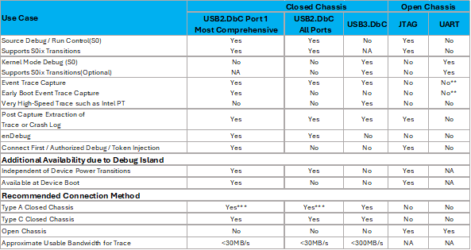
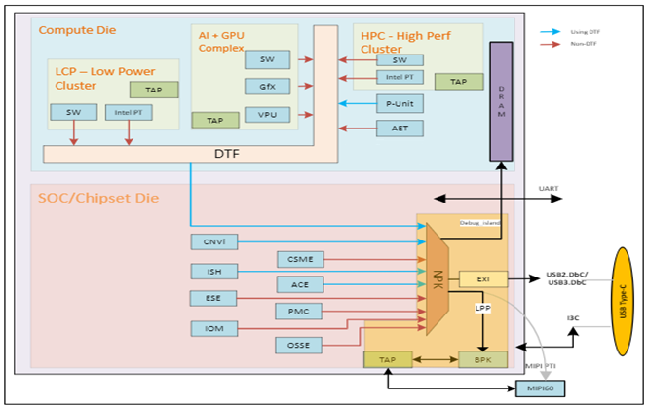
WCL SoC Debug Port Capabilities
NOTE :
**Typically, only used for BIOS Trace during early development
***Need to enable USB2.DbC using BIOS or FIT setting

Slide 93
USB2/USB3 DbC port mapping & RVP Ref Des Details
USB Ports Bifurcation | Port# | WCL DDR5 T3 RVP1 U-01 |  | WCL LP5x T3 RVP2 U-04
 |  | Port Type | Ref Des | Port Type | Ref Des
USB3.2 Gen2x1 Bifurcation | P1 | USB3.2 Gen2x1 TAP-1 | J1C3 | USB3.2 Gen2x1 TAP-2 | J1E1
 | P2 | USB3.2 Gen2x1 TAP-2 | J1E1 | USB3.2 Gen2x1 TAP-1 | J1C3
USB2.0 Bifurcation | P1 | TCP-0 (TCSS AIC-1) | J4B1 | TCP-0 (TCSS AIC-1) | J4B1
 | P2 | TCP-1 (ONBOARD TBT) | J9B1 | TCP-0 (TCSS AIC-1) | J8B1
 | P3 | USB3.2 Gen2x1 TAP-1 | J1C3 | USB3.2 Gen2x1 TAP-2 | J1E1
 | P4 | USB3.2 Gen2x1 TAP-2 | J1E1 | USB3.2 Gen2x1 TAP-1 | J1C3
 | P5 | NA (Need USB FP cable) | J6B4 | NA (Need USB FP cable) | J6B4
 | P6 | NA (Need USB FP cable) | J6B4 | NA (Need USB FP cable) | J6B4
 | P7 | NA (Rework option and need USB FP cable) | J1D1 | NA (Rework option and need USB FP cable) | J1D1
 | P8 | NA (Rework option and need USB FP cable) | J1D1 | NA (Rework option and need USB FP cable) | J1D1

Slide 94
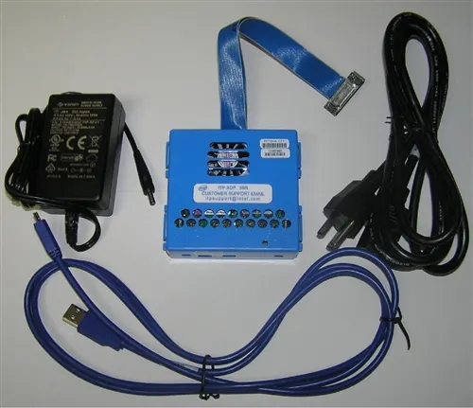
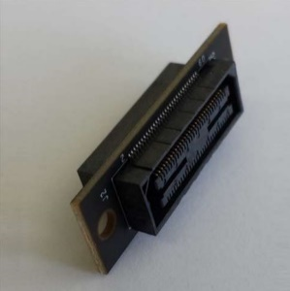
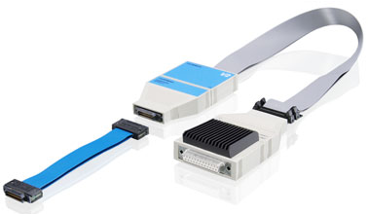
Traditional XDP/LTB support on WCL RVP – open chassis debug
XDP : WCL RVP supports traditional XDP probe over MIPI60 header for JTAG functionality. Make sure to use adaptor card for compatibility with MIPI60 header
Lauterbach(LTB) : Lauterbach Trace32 is used as the open chassis debug tool and connected via MIPI-60. The supported features are :
Run-control
Trace extraction and analysis
Streaming trace via MIPI PTI (Intel Processor Trace)
CrashLog extraction and analysis
Custom Scripts (CScripts)
Adaptor card
Link for adaptor details : https://designintools.intel.com/product_p/itpmipi602itp60v2.htm

Slide 95
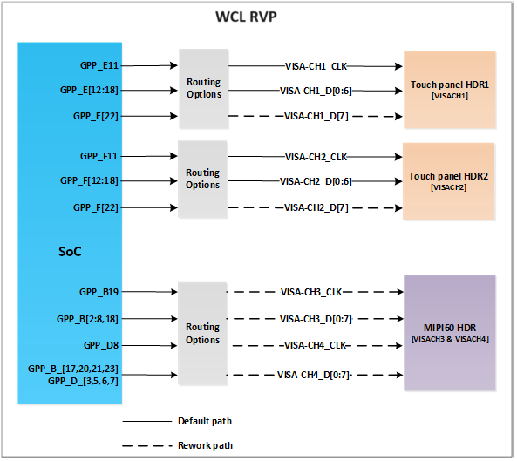
MIPI60/Touch Panel Header VISA support – open chassis debug
Observe VISA data with a logic analyzer on the Touch Panel Header
Calibrated TLA + THC Rework on RVP + High/Low-speed adaptor + New VISA Cable for Touch Panel + GPIO enabled in BIOS menu
Observe VISA data with a logic analyzer on the MIPI60 Header
Calibrated TLA + PCH Rework on RVP + High/Low-speed adaptor + GPIO enabled in BIOS menu.
Notes:
VISA to Pins
2 byte-lanes, 1b of clock on each lane (16b of data, 2b of clock)
Using VISA clock
VISA to Pins (Async)
Bypass the flops and sample the signals using LA
Async mode is recommended when working with LA
Touch Panel (VISA) to Pins (Sync)
2 byte-lanes, 1b of clock on each lane (16b of data, 2b of clock)
Using VISA clock
Touch Panel (VISA) to Pins (Async)
Bypass the flops and sample the signals using LA
Async mode is recommended when working with LA

Slide 96
Additional Tools and Cables
MIPI60-to-LAI HS Adapter(For VISA only):
https://wiki.ith.intel.com/display/PEVH/MIPI60-to-LAI+High-Speed+Adapter
MIPI60 to LAI Adapter:
https://wiki.ith.intel.com/display/PEVH/MIPI60-to-LAI+Adapter
LNL VISA Debug Cable:
https://wiki.ith.intel.com/display/PEVH/LNL+VISA+Debug+Cable
Intel® Silicon View Technology Closed Chassis Adapter (also known as SVTCCA or BSSB) from below given link :
https://designintools.intel.com/ProductDetails.asp?ProductCode=ITPXDPSVT
Closed Chassis Debug Technologies (BSSB, DbC etc)
https://wiki.ith.intel.com/display/ccd/CCD+Technologies
MIPI60 Lauterbach Connector and interface details
http://goto/IntelDPS
Lauterbach details
http://goto/lauterbachpricing

Slide 97
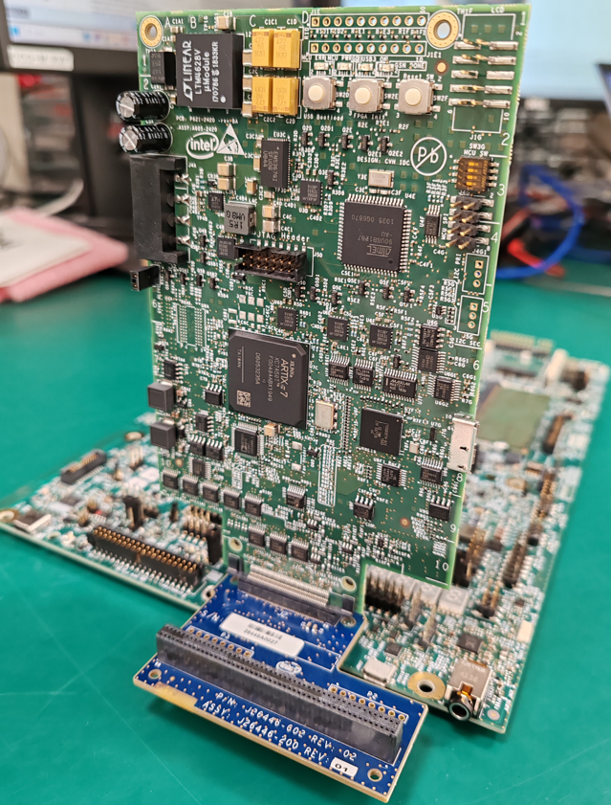
SINAI2/NEVO connector
WCL RVP Supports SINAI2 connector (Merged AVMC + SINAI) for Margining customers.
WCL also supports Nevo ( which is the Low-Cost SINAI) Low-cost version of Sinai2 - Full compatibility to Sinai2 drivers, SW and automation.
Connector IPN | Description
D10221-001 | CONN,MISC,100 P,SM 5MM
Assembly P/N | Description
H90193-001 | NEVO KIT A602-2420

Slide 98
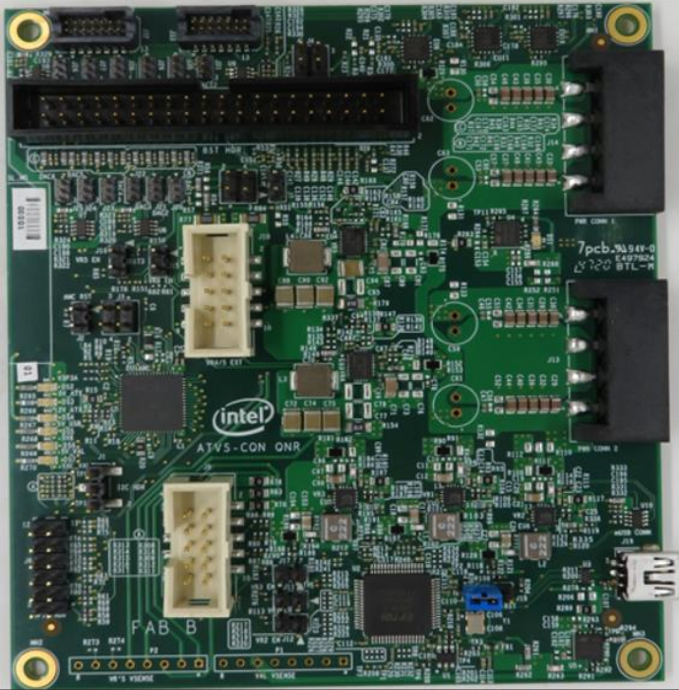
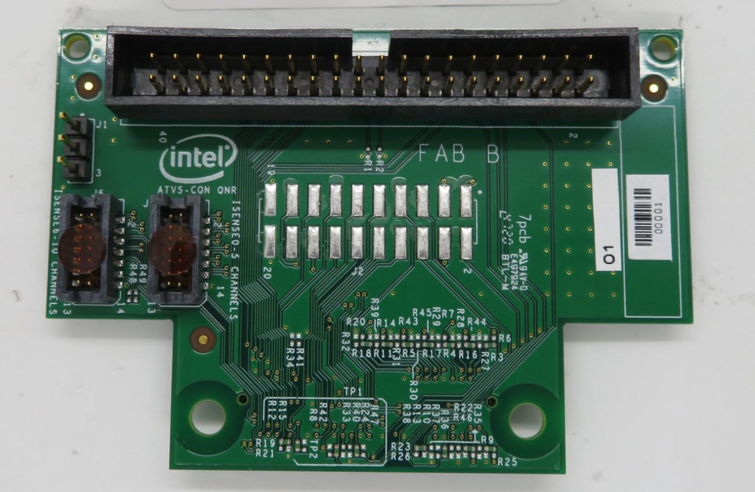
BOX STRESS TOOL (BST)
BST is an AIO integrated solution used for Voltage measurements, Voltage drive/margining, GPIO's manipulations, I2C master controller and Thermal Diodes measurements capabilities.
BST hooks on to RVP 100pin Nevo connector with use of NTB adapter for ADC, DAC , GPIO’s , ISENSE and I2C Controller functions.
For SoC Thermal Diodes measurements and BST onboard VR’s auxiliary use case, dedicated cables are available as part of BST Kit.
IPN | Description
M37664-001 | BST FAB B Kit
IPN | Description
K87826-001 | NTB Adapter
IPN | Description
M37665-001 | NTB FAB B Kit
NEVO to BST Adapter ( NTB FAB B )
BST Test Card

Slide 99
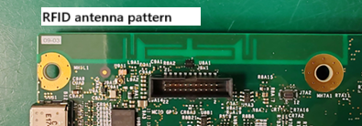
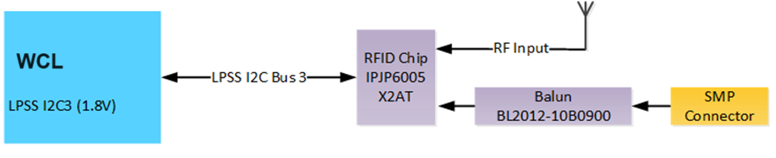
Processor Secure Storage(PSS)
Processor Secure Storage or PSS is a RFID based solution used in RVP to store board related information like Board SL No, Board ID.
IPJ-P6005-X2BT is the PSS IC is used. It is a UHF (860-960MHz) Gen2 RFID IC with 8K non-volatile memory and I2C interface. This IC operates as a standard I2C EEPROM and it can also be accessed wirelessly.
The board related details stored is read over I2C lines from the SOC.

Slide 100
Debug Hooks Supported on WCL RVP
SINAI2/NEVO/BST
SAS Header
Thermal INTEC Connector
SMP Probe Points
PM Side Band Header
KB (PS2)
uAB serial debug port
DediProg SF600 programmer
PORT 80
PSS Support

Slide 101
TTK3 support on RVP
Any query related to TTK tool, please use the following contacts:
HW: sapir.buzaglo@intel.com
SW: adi2.levy@intel.com
Link for TTK collateral is as follow:
TTK3 Releases
TTK Wiki

Slide 102
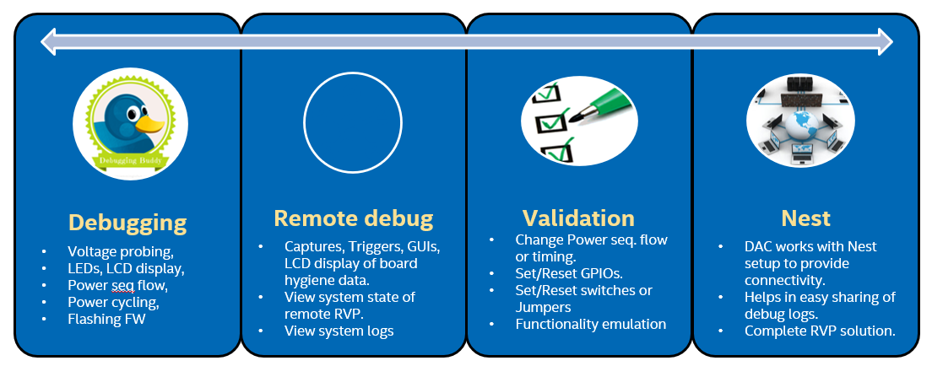
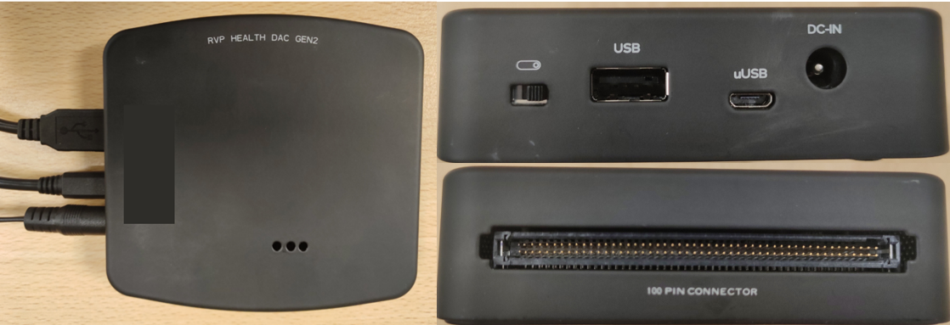
DAC & UCP-SQUID support on RVP
DAC (Debug Acceleration Card) for the purpose to facilitate faster remote debug, monitoring and root cause the issues is support on RVP.
Link for DAC collateral is as follow:
https://goto.intel.com/rvpdac
UCP-SQUID is one tool supporting multiple programming hardware also support on RVP.
Link for UCP-SQUID collateral is as follow:
https://wiki.ith.intel.com/display/PEVH/Squid

Slide 103
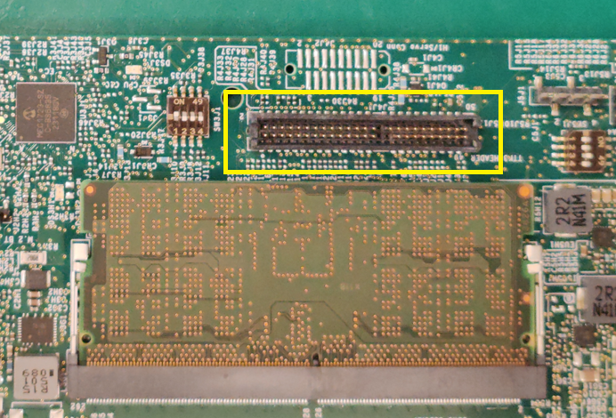
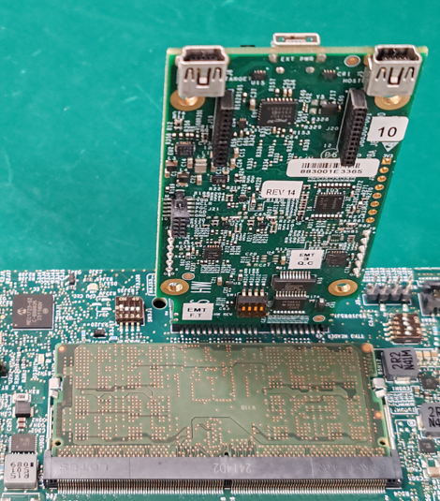
BIOS programming using TTK3 Connector
TTK3 header is a 50-pin receptacle which can also accept 20-pin DediProg header or TTK3 HW to program the IFWI. Please insert the DediProg header as shown below. Make sure that the notch marked matches with the notch of the DediProg header.
If using TTK3, make sure the latest version of the TTK3 GUI (1.4.8, link) is installed in the host machine. With latest GUI, TTK3 FW update will happen while connecting TTK3 HW for the first time. Note: Without latest GUI version, longer flashing time is expected!

Slide 104
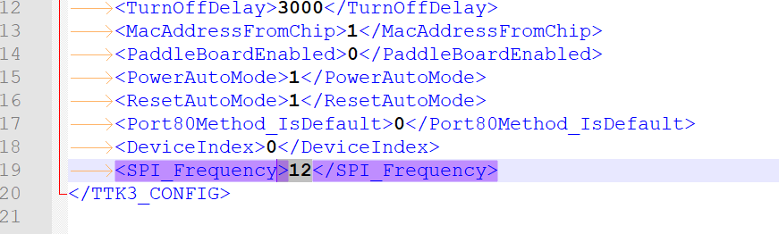
TTK Programming Frequency Selection
WCL RVP is having Flash0 POR frequency as 100MHz. As tradeoff to this, TTK/TPM path max frequency is limited to 14MHz in the RVP.
While using TTK3 for flashing, the frequency of operation must be set to 12MHz for reliable operation.
In the host PC with TTK3 GUI, open: C:\SVShare\user_apps\TTK3_Configurations.xml
Modify SPI_Frequency to 12 in the below placeholder;

Slide 105
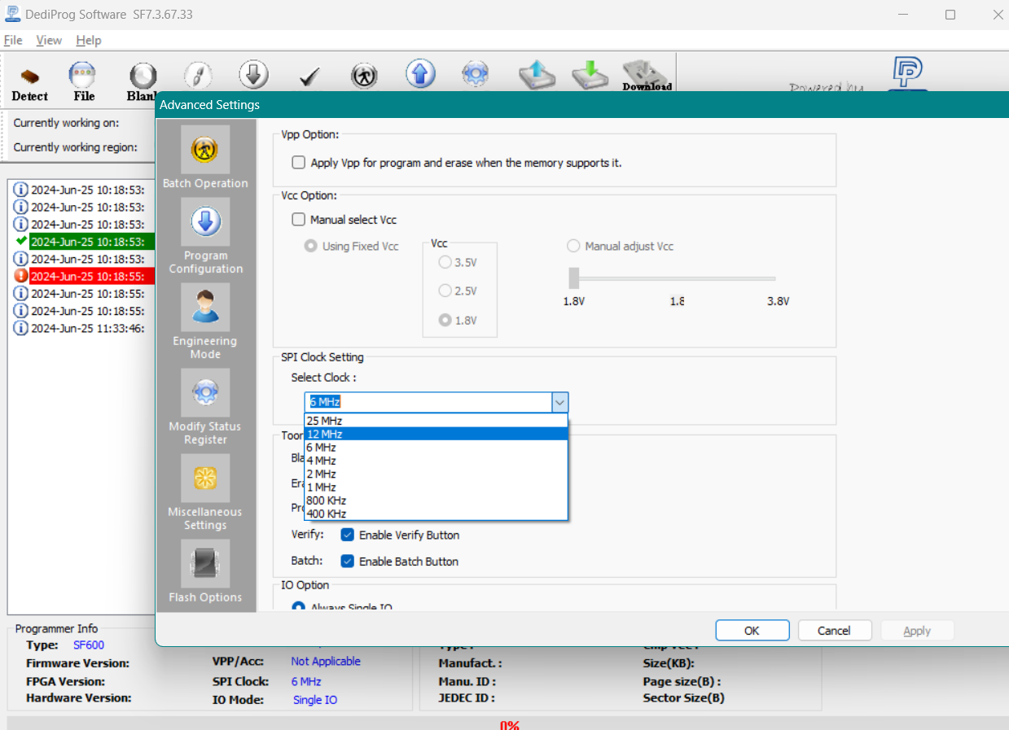
DediProg/SF600 Frequency Selection
WCL RVP is having flash0 POR frequency as 100MHz. As tradeoff to this TTK/TPM path max frequency is limited to 14MHz in the RVP.
While using DediProg/SF600 for flashing, the frequency of operation must be set to 12MHz for reliable operation.
In the DediProg software: Config -> Miscellaneous Settings → select frequency 12MHz.

Slide 106
Power Delivery Implementation Details
Au, Chun Ming

Slide 107
WCL RVP – Power Sources to boot WCL RVP boards
WCL design supports three different power sources to boot RVP boards,
AC Adapter:
A 230W (19.5V, 11.8A) adapter is being selected for the WCL RVP and is one of the three power sources which can be used for powering the RVP.
Existing 230W AC brick (model #: PA-1231-12, IPN: J82210-001)
New AC brick (model #: PA-1231-16, IPN: N44540-001)
Type C Adapter:
There are two USB-C ports supported on WCL RVP, all ports are USB-C PD 3.1 compatible and can be used for plugging in the Type C adapter. EPR chargers more than 20V are NOT supported.
Note: For dead battery boot with type-c adapter, minimum 45W adapter is required to boot the WCL RVP.
Battery Pack:
A 3S1P battery pack is being selected for WCL RVP with maximum capacity of 61.5Whr. 3S1P battery pack IPN: M77304-001
Recommendation: Use standard AC adapter for all validations. Only on need basis, use Type C adapter or battery pack.

Slide 108
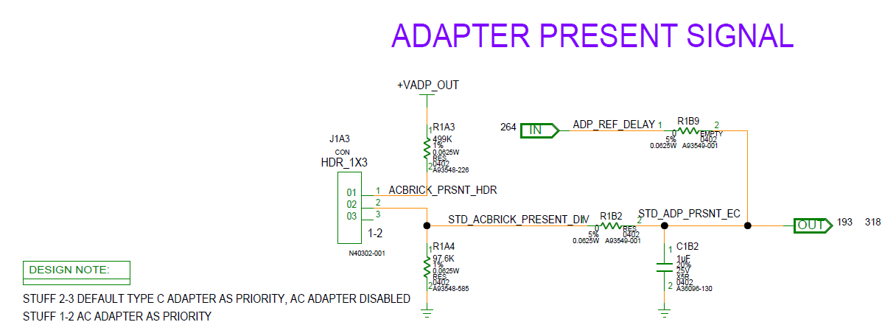
WCL RVP – Power Source Priority
Available Sources | Priority Given To
Standard AC Adapter + Battery Pack | Standard AC Adapter (Header: 1-2)
Standard AC Adapter + Type C Adapter | Standard AC Adapter (Header: 1-2)
Standard AC Adapter + Type C Adapter + Battery Pack | Standard AC Adapter (Header: 1-2)
Type-C Adapter + Battery Pack | Type-C Adapter (Header: 1-2)
Standard AC Adapter + Battery Pack | Standard AC Adapter (Header: 2-3)
Standard AC Adapter + Type C Adapter | Type C Adapter* (Header: 2-3)
Standard AC Adapter + Type C Adapter + Battery Pack | Type-C Adapter * (Header: 2-3)
Type-C Adapter + Battery Pack | Type-C Adapter (Header: 2-3)
Note: Smooth/seamless transition from Type-C adapter to AC adapter and vice versa is not supported if battery is not connected.
*WCL RVP design will incorporate a jumper solution which will allow higher priority to be assigned to Type C power in case both AC Barrel and Type C power is connected. This POC will be implemented on both RVP1 and RVP2.

Slide 109
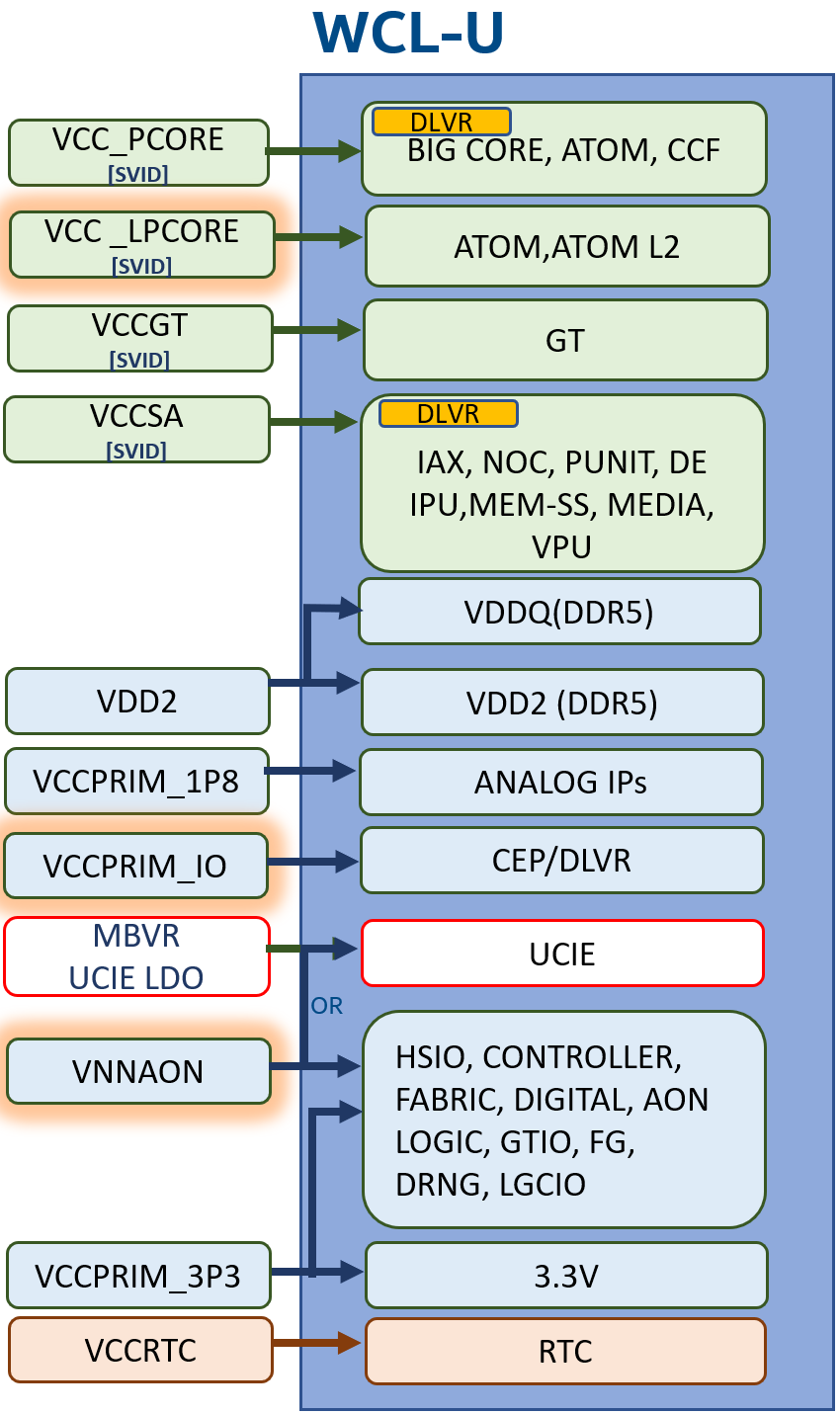
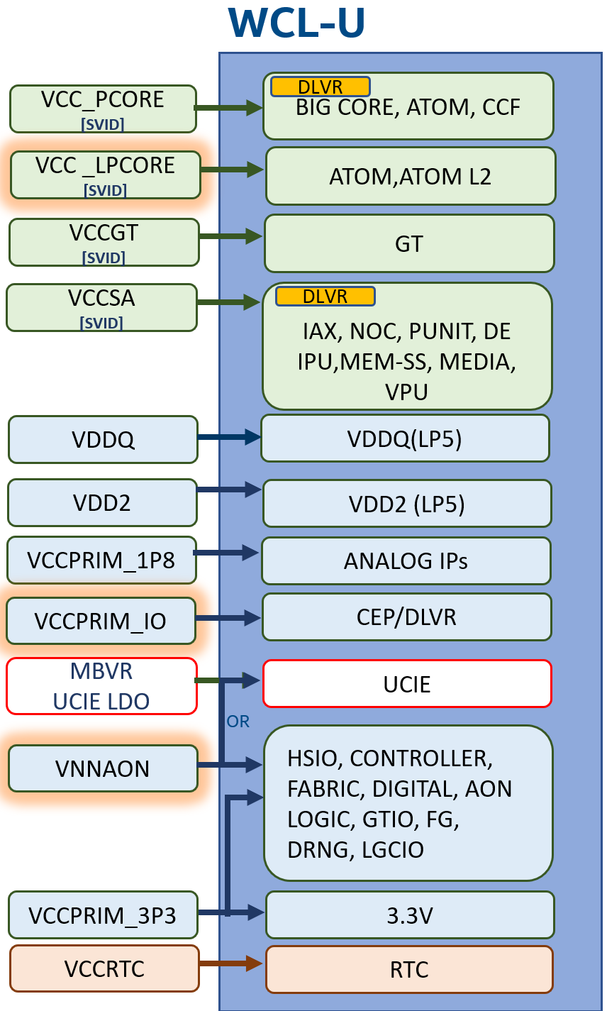
WCL RVP SoC rails overview (POR)
DDR5
LP5x
Notes:
Diff memory technology different power delivery solutions
Soc power solution is for the superset design

Slide 110
WCL RVP IMVP rail overview
Processor | WCL VCC_PCORE + VCCGT + VCCSA + VCC_LP_ECORE | Remarks
Processor Base Power – 15W SKU | 1+1+1+1
Four SVID rails in WCL:
Rail | VCC_PCORE | VCCGT | VCCSA | VCC_LP_ECORE
Phase Count | 1 | 1 | 1 | 1
ICCMax (A) | 40 | 40 | 35 | 28
ICCMax.App (A) | N/A | N/A | N/A | N/A
IPL2/TDC (A) | 23 | 20 | 20 | 11
DCLL (mΩ) | 5.2 | 6.6 | 7.5 | 7.5
FVM Support | ✕ | ✕ | ✕ | ✕
Notes:
VCCGT ICCMAx 97 and VCCSA ICCMAx 52

Slide 111
WCL RVP power rail overview
Voltage Regulator | Default Voltage | Comments
+VCC_PCORE | 0V (Boot Voltage) 0.52-1.52V | CPU adjusts the output voltage through SVID.
+VCCGT | 0V (Boot Voltage) 0.52V-1.26V | CPU adjusts the output voltage through SVID.
+VCCSA | 0V (Boot Voltage) 0.52V-1.23V | CPU adjusts the output voltage through SVID.
+ VCC_LP_ECORE | 0V (Boot Voltage) 0.52V-1.52V | CPU adjusts the output voltage through SVID.
+VNNAON | 0.77V | POR for UCIe
+VCCST | 0.77V | MB PG From VNNAON
+VDD2H | 1.065V (LP5x Mem Down) | Shared rail (LP5x memory + CPU) in LP5x SKU
 | 1.1V (DDR5) | SoC Only (DDR5)
+VDDQ | 0.52V(LP5x Mem Down) | Shared rail (LP5x memory + CPU) in LP5x SKU
 | 1.1V Tied with +VDD2H | SoC Only (DDR5)
+VDD2L | 0.92V | Applicable for only LP5x memory (For DVFSC support)
+VDD1 | 1.8V (LP5x Mem Down) | LP5x Only
+VCCPRIM_IO | 1.25V
+VCCPRIM_UCIE | 0.77V | UCIe LDO
+V3.3A | 3.3V
+V5A | 5.1V
+V1.8A | 1.8V
DDR5 rail | 5V | DRAM module only (DDR5 only)
Notes:
As per mem technology

Slide 112
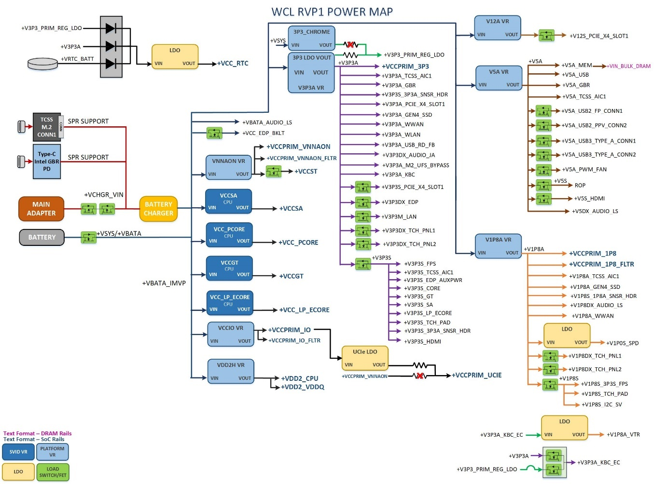
WCL RVP1 Platform Power Map
WCL RVP1 Platform Power Map LINK
Notes:
Call out Pg 6 for each sku

Slide 113
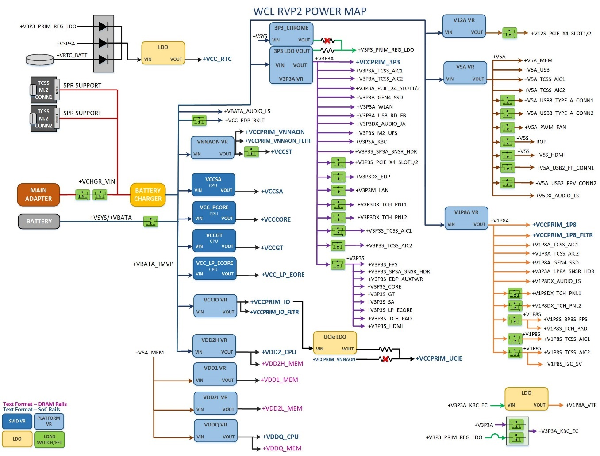
WCL RVP2 Platform Power Map
WCL RVP2 Platform Power map LINK
Notes:
Call out Pg 6 for each sku

Slide 114
WCL RVP– Key PD Sub-systems
Battery Charger:
A buck-Boost NVDC charger is used to charge the battery pack and to power the system with the input voltages from standard AC adapter and Type-C adapters.
Discrete VRs:
Discrete voltage regulators are required for powering the CPU (non-SVID), PCH and platform components, power sequencing and load switches form the RoP power delivery sub-system.
IMVP 9.3 VRs:
WCL CPU requires four different SVID rails (VCC_PCORE, VCCGT, VCCSA and VCC_LP_ECORE). An IMVP9.3 compliant controller is used for generating these rails.
Notes:
Programming thru external I2C host possible e.g. AADVARK

Slide 115
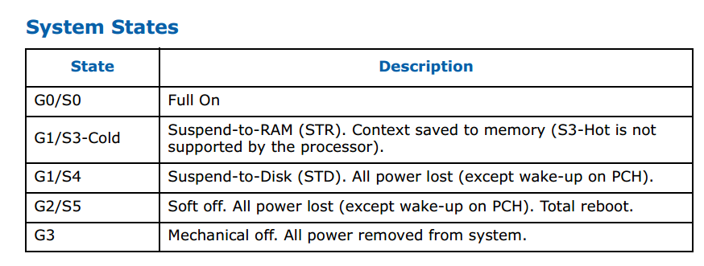
WCL RVP System State overview
WCL supports the following system states and detailed voltage rail information is presented in next slide. By default, all the SKU supports pseudo –G3 state
DSx is not supported.
Notes:
All Legacy Power states supported

Slide 116
WCL RVP2– Sequencing Block Diagram
G3 State
+V3P3_PRIM_LDO
+V3P3A
2
4
VCCRTC
RTCRST#
SRTCRST#
SoC
+VRTC_BATT
VIN VOUT
1.5V LDO
EN
5
1
3
5

Slide 117
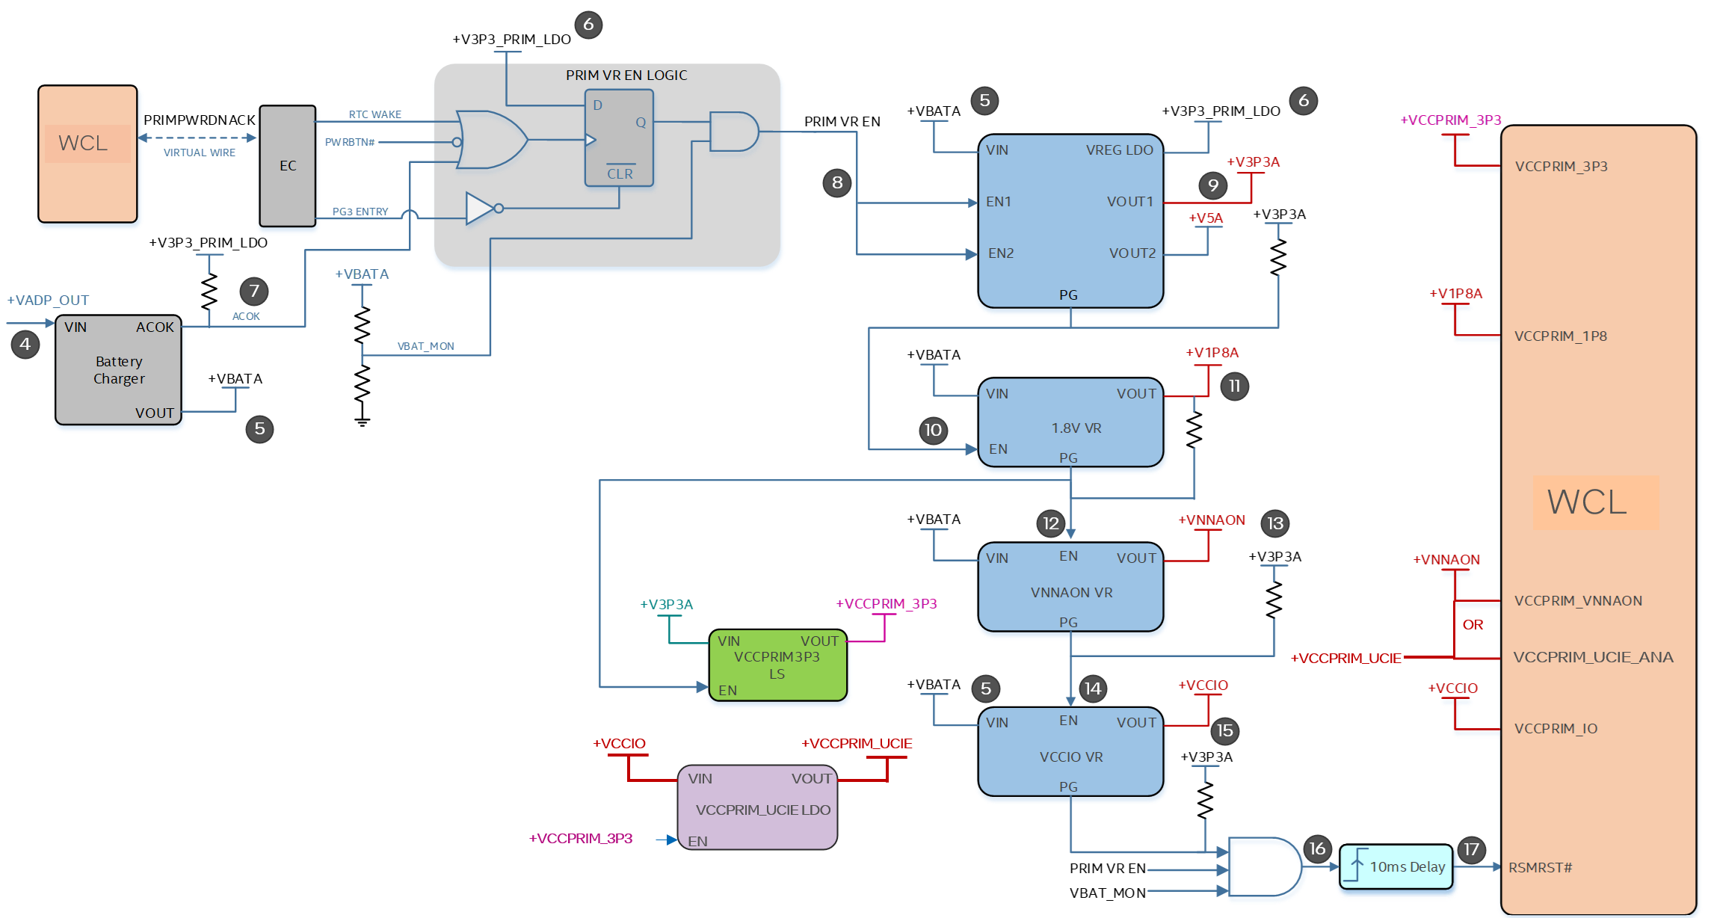
G3 to S5 State Transition

Slide 118
S5 to S0 State Transition
+V5A
20
19
6
21
18
19
30
30
18
23
21
18
19
18
23
22
24
18
26
25
26
WCL
24
27
27
VDDQ
28
29
29
28
30
32
30
35
17
31
18
36
20

Slide 119
WCL RVP– Power Sequence
Primary Rail Order (Fixed Rails for DDR5 & LP5)
+V3P3A/+V5A
+V1P8A
+VCCPRIM_3P3
+VCCPRIM_IO
+VCCPRIM_VNNAON
Memory Rail Order (Fixed Rails for DDR5)
+VIN_BULK_DRAM
+VDD2_CPU
Memory Rail Order (Fixed Rails for LP5)
+VDD1_MEM
+VDD2H_CPU/ +VDD2H_MEM
+VDD2L_MEM
+VDDQ_CPU/ +VDDQ_MEM

Slide 120

PG3 Logic Overview
Pseudo G3 state wake events:
Adapter insertion
Power button press
RTC wake event from EC
System enter PG3 state:
System enters PG3 state only with Battery pack/Virtual battery
EC drives EC_PG3 signal enables the PG3 mode, which intern drives PRIM_VR_EN Low

Slide 121
WCL RVP– Power States Map
VR / Gated Rail name | Enable | Voltage (in V) | S0 (active) | S0 | S0iX | S3 | S4 | S5 | PG3 | G3
+V1P5_RTC | +VRTC_BATT (coin cell battery) | 1.50 | ON | ON | ON | ON | ON | ON | ON | ON
+VBATA | PRIM_VR_EN | 3S topology, 9V-13.05V | ON | ON | ON | ON | ON | ON | OFF | OFF
+V3P3A | PRIM_VR_EN | 3.30 | ON | ON | ON | ON | ON | ON | OFF | OFF
+V5A | PRIM_VR_EN | 5.15 | ON | ON | ON | ON | ON | ON | OFF | OFF
+V1P8A | V5A_V3P3A_VR_PWRGD | 1.80 | ON | ON | ON | ON | ON | ON | OFF | OFF
+VCCPRIM_3P3 | V1P8A_PWRGD | 3.30 | ON | ON | ON | ON | ON | ON | OFF | OFF
+VNNAON / +VCCPRIM_UCIE | VCCPRIM_3P3 | 0.77 | ON | ON | ON | ON | ON | ON | OFF | OFF
+VCCPRIM_IO | VNNAON_VR_PWRGD | 1.25 | ON | ON | ON | ON | ON | ON | OFF | OFF
+VDD1_MEM | PM_SLP_S4_N | 1.80 | ON | ON | ON | ON | OFF | OFF | OFF | OFF
+VDD2H_CPU | VDD1_VR_PWRGD | 1.065 | ON | ON | ON | ON | OFF | OFF | OFF | OFF
+VDD2L_MEM | VDD2H_VR_PWRGD | 0.92 | ON | ON | ON | ON | OFF | OFF | OFF | OFF
+VDDQ_CPU | VDD2L_VR_PWRGD | 0.52 | ON | ON | ON | ON | OFF | OFF | OFF | OFF
+V5S | PM_SLP_S3_N | 5.18 | ON | ON | ON | OFF | OFF | OFF | OFF | OFF
+V1P8S | PM_SLP_S3_N | 1.80 | ON | ON | ON | OFF | OFF | OFF | OFF | OFF
+V3P3S | PM_SLP_S3_N | 3.30 | ON | ON | ON | OFF | OFF | OFF | OFF | OFF
+VCCST | VCCST_EN | 0.77 | ON | ON | ON | OFF(Except Crash log) | OFF | OFF | OFF | OFF
+VCCCORE | ALL_SYS_PWRGD | 0-1.52V | SVID | SVID | 0V (boot) | OFF | OFF | OFF | OFF | OFF
+VCCGT | ALL_SYS_PWRGD | 0-1.52V | SVID | SVID | 0V (boot) | OFF | OFF | OFF | OFF | OFF
+VCCSA | ALL_SYS_PWRGD | 0-1.52V | SVID | SVID | 0V (boot) | OFF | OFF | OFF | OFF | OFF
+VCC_LP_ECORE | ALL_SYS_PWRGD | 0-1.52V | SVID | SVID | 0V (boot) | OFF | OFF | OFF | OFF | OFF

Slide 122
WCL RVP– Voltage Margining Feature
Voltage Rail | VR Controller | Nominal Voltage | Supported Voltage Range | Voltage Margining Support
+V3P3A | RT6585AGQW | 3.3V | 2.97V to 3.63V | Supported With AVMC | Supported With Sinai2/Nevo
+V5A | RT6585AGQW | 5.15V | 4.5V to 5.5V | Not Supported | Not Supported
+V1P8A | RT6220AGQUF | 1.8V | 0.6V to 5V | Supported With AVMC | Supported With Sinai2/Nevo
+VCCPRIM_VNNAON +VCCPRIM_VNNAON_FLTR | TPS51219RTER | 0.77 | 0.7V to 3.3V | Supported With AVMC | Supported With Sinai2/Nevo
+VCCPRIM_IO | TPS51396A | 1.25 | 0.6V to 5.5V | Supported With AVMC | Supported With Sinai2/Nevo
+VDD1_MEM | RT5795AG | 1.8V | 0.5V to 3V | Supported With AVMC | Supported With Sinai2/Nevo
+VDD2_CPU +VDD2H_MEM | RT8231 | 1.065V | 0.75V to 3V | Supported With AVMC | Supported With Sinai2/Nevo
+VDD2L_MEM | RT5795AG | 0.92V | 0.5V to 3V | Supported With AVMC | Supported With Sinai2/Nevo
+VDDQ_CPU / +VDDQ_MEM | RT5795A | 0.52V | 0.45V to 1V | Supported With AVMC | Supported With Sinai2/Nevo
Note: IMVP rails can be margined through SVID
Notes:
AVMC : Analog Validation Margining Card

Slide 123
WCL RVP – Power Measurement
WCL design is single board approach for both PI and PnP board.
Sense lines from sense resistors are routed to multiple 2x7 headers which are on the Bottom side of the board
Spider card needs to be used along with RVP to do power measurement using NI DAQ setups.
WCL design has 10 system meter to measure critical SoC/Platform rails as per PnP requirement. Addition to this, 3 more system meter is incorporated for the core rail voltage measurement via Remote sense lines specifically for IVE PnP team through PAC Pro.
Additionally, WCL RVP also supports Energy Telemetry measurement via System Meter.
Note: Click here for power measurement mapping.

Slide 124

WCL RVP – Cost Optimization
For the cost optimization, in WCL we have replaced the most of the Non-critical PMRs to Copper Shunts for the NON-PnP SKUs
Note: For energy telemetry configuration, these PMRs will not change to shunt.
Details of the PMRs which are replaced with Cu Shunts for each RVP is provided in the link below
LINK

Slide 125
WCL RVP – debug hooks
WCL design supports virtual battery implementation via Switch setting
DLVR TP Signals are routed to 2x7 header for monitoring.
WCL design supports coin-cell less design implementation through rework, default configuration is coin cell-based implementation.

Slide 126
Quick Start
R, Hemananth

Slide 127
Quick Start
Required Peripherals:
MCP socket and MCP
Heat sink assembly for MCP
Memory DRAM IC’s or Module (SKU dependent)
Mobile 19V AC Brick (Reuse from Previous platform)
Keyboard, Mouse (USB)
M.2 SSD
External display (e.g eDP Panel)
SF600 programmer for BIOS programming
Micro USB cable for debug log

Slide 128
Board Bring up Steps
Make sure all peripheral’s mention in previous foil is available before starting board bring up. Considered LP5x T3 board reference designators are used in below steps provided.
Step 0:
Please go to the WCL RVP Rework tracker to know all applicable rework by searching based on RVP Work Order (WO).
Rework Portal Link : (https://intellabs.service-now.com/rework?id=work_order_form)
Step 1:
Place the processor (RefDes:U4E1) with socket and the hardware assembly (make sure to align the chip to the pin 1 marking).
Step 2:
Assemble the LP5x memory or DDR5 SODIMM based on the RVP SKU.
Step 3:
Verify presence of RTC coin cell in Battery Holder (RefDes:XJ1B2).
Step 4:
Insert SSD – PCIe based SSD in M.2 socket (RefDes: J7E1 [M.2 SSD Gen4] ).

Slide 129
Board Bring up Steps
Step 5:
Connect eDP display (RefDes: J1C2). If initial silicon does not support graphics, then use PCIe CEM slot connector (RefDes: J8C1) with the help of external graphics card (Recommended to use Single width Graphics card) Note: PCIe CEM slot2(J6C3) is rework port
Step 6:
Connect a USB keyboard and mouse on default USB ports (RefDes: J1E1 & J1C3). Note: Vertical Type A USB port close to LAN connector is rework port on all sku except PPV sku
Step 7:
Insert DediProg (RefDes: J1F2) and follow steps to flash IFWI image (EC+BIOS merged image).
Step 8:
Connect the AC brick ((RefDes: J1A1) or battery pack(3S1P IPN M77304-001 ) or Type C adapter (Along with TCSS702 module) to provide power to board.
Step 9:
As the system boots, press F2 to enter the BIOS setup screen.
Check time, date, and configuration settings. The default settings should be sufficient for most users.
Save and exit the BIOS setup. The system boots and is ready for use.

Slide 130
SF600 programming
Can be programmed in Single I/O mode as well as quad mode for more speed.
Connect DediProg SF600 to header at RefDes: J1F2 on WCL LP5x T3 RVP board
SET IO MODE: Launch the DediProg tool and confirm the settings from config → miscellaneous settings → Single IO option → Enable single IO. Default is single I/O
SET FREQUENCY: Launch the DediProg tool and confirm the settings from config → miscellaneous settings → Select Clock → 12MHz. Ideal frequency for RVP programming is 12MHz.
DediProg tool version details “SF7.4.20.12”.
Tool Link :
For WCL, no separate images for BIOS(0x12000000) & EC(0x4000). It will be a single merged IFWI image.
Go to “file” and select the .bin file.
Execute the batch operation to erase and program the chip.
DEDIPROG

Slide 131



SPI through Dediprog SF600 ..cont
Note:
For SF600 programmer and top side connector of Adaptor Card which connect to programmer: Pin 1 at top left.
Adaptor Card B & Cable
Pin 1
Pin 1
Top view of 2x10 connector on Motherboard (J1F2)
Notes:
Check for Port0 or 1 start.

Slide 132
Jumpers on WCL RVP1 SKU
Note: This setting is subjected to be changed w.r.t. SKUs as per ref des and functionality.
Jumper Description | Ref des | Default
AC BRICK PRESENT | J1A3 | (1-2)
ESPI FLASH SHARING MODE | J1D2 | (2-3)
MIPI60_PRESENT1 | J1E2 | (2-3)
+V3P3_MUX_RTC | J2B1 | (2-3)
TOP SWAP OVERRIDE GPP B14 STRAP | J2B2 | (2-3)
BUF_TXD | J2G1 | (1-2)
HDR_V1P8A | J2H1 | (2-3)
FUSA_DIAGTEST_EN | J2H2 | (2-3)
DAC_EXIT_GPIO | J2J3 | (2-3)
COINLESS_MODE_PU | J3B2 | (2-3)
GPPC_D12_NOREBOOT | J5C1 | (2-3)
VCCIO_UCIE_EN | J5D1 | (1-2)
VCCIO_UCIE_VIN | J5D2 | (1-2)
+V3P3S_VAL_J | J6G2 | (1-2)
H_PECI | J6H1 | (2-3)
BUF_RXD | J6J1 | (1-2)
CLKREQ2_X4_GEN4_DT_CEM_SLOT1 | J7E2 | (1-2)
SMB_CLK_S3; SMB_DATA_S3 | J7G1 | (1-3;2-4)
MIC_PRIVACY_SW_OUT | J7H3 | (2-3)
GBR_PD_GND | J8B2 | (1-X)
Jumper Description | Ref des | Default
+V3P3A_VAL_R | J8E1 | (2-3)
DNX_FORCE_RELOAD_HDR | J9C2 | (2-X)
CATERR_LED_DRV | J9D1 | (2-X)
+V1P8A_PD_USBC | J9E1 | (2-3)
SRTC_RST_N | J9E2 | (1-X)
+V3P3A_PD_USBC | J9E3 | (2-3)

Slide 133
Switch on WCL RVP1 SKU
Note: This setting is subjected to be changed w.r.t. SKUs as per ref des and functionality.
Ref Des | Switch Description | Default
SW1U1 | EC_SPI_CS0_SW_N EC_SPI_WP_SW | 1-8(ON), 2-7(ON), 3-6(OFF), 4-5(OFF)
SW1U2 | PCH_SPI_SEL PCH_SPI_SEL PM_RSMRST_EC_N RSMRST_PWRGD_EC_N | 1-8(OFF), 2-7(ON), 3-6(ON), 4-5(ON)
SW2D1 | BT_RF_KILL_SW_N WIFI_RF_KILL_SW_N EC_PM_PCH_PWROK WWAN_DISABLE_N | 1-8(OFF), 2-7(OFF), 3-6(ON), 4-5(OFF)
SW2D2 | IMVP_VR_EN IMVP_CONFIG0 IMVP_CONFIG1 DEBUG_TRACE_PNP | 1-8(OFF), 2-7(ON), 3-6(OFF), 4-5(OFF)
SW3J1 | SAF_G3_DETECT VIRTUAL_DOCK_DET_N VIRTUAL_BATTERY FLIP_TO_TABLET_MODE | 1-8(ON), 2-7(OFF), 3-6(OFF), 4-5(OFF)
SW5J1 | PEN_DETECT_SW BATT_ID_R INTRUDER_N_PU INTRUDER_N_PD | 1-8(OFF), 2-7(OFF), 3-6(ON), 4-5(OFF)
Ref Des | Switch Description | Default
SW6A1 | TCSS1_EC_PD_I2C_VD1_ADDR TCSS1_EC_PD_I2C_VD2_ADDR TCSS1_EC_PD_I2C_VD3_ADDR TCSS1_A2D_I2C1_ADDR | 1-8(ON), 2-7(OFF), 3-6(OFF), 4-5(OFF)
SW6H1 | EC_UART_FLASH_PROG PMC_GPIO_BOOT_HALT PROCHOT_EC_N BOOTHALT_N | 1-8(OFF), 2-7(OFF), 3-6(OFF), 4-5(OFF)
SW8R1 | BOM_ID2 BOM_ID1 BOM_ID0 | 1-8(ON), 2-7(ON), 3-6(ON), 4-5(OFF)
SW8R2 | VCC_VCCPRIM_IO_SENSE_DP +VCC1P5_RTC_VAL VCC_VCCPRIM_IO_SENSE_DN GND | 1-8(ON), 2-7(OFF), 3-6(ON), 4-5(OFF)
SW8U1 | EC_JTAG_RST_N BIOS_REC PNP_NPNP_SKU SPD_PRSNT_J | 1-8(OFF), 2-7(OFF), 3-6(OFF), 4-5(ON)
SW8U2 | SMC_RST_N SMC_LID EC_PG3 SLG_EC_VR_A_RAIL_EN | 1-8(OFF), 2-7(OFF), 3-6(OFF), 4-5(OFF)
SW8U3 | EC_UART_FTD_RX_OUT EC_UART_RX_TTK3_OUT COINLESS_SPI_NOR_CLEAR_SW ESPI_TESTCRD_DET | 1-8(ON), 2-7(OFF), 3-6(OFF), 4-5(OFF)

Slide 134
Switch on WCL RVP1 SKU Contd…
Note: This setting is subjected to be changed w.r.t. SKUs as per ref des and functionality.
Ref Des | Switch Description | Default
SW9R1 | VAL_TP_VCC_PCORE_1_DLVR_OUT_DP +VCCPRIM_1P8 VAL_TP_VCC_PCORE_1_DLVR_OUT_DN GND | 1-8(ON), 2-7(OFF), 3-6(ON), 4-5(OFF)
SW9R2 | VAL_TP_VCC_CCF_0_DLVR_OUT_DP VAL_TP_VCCINFVNN_DLVR_OUT_DP VAL_TP_VSS_CCF_0_DLVR_OUT_DN VAL_TP_VSSINFVNN_DLVR_OUT_DN | 1-8(ON), 2-7(OFF), 3-6(ON), 4-5(OFF)
SW9R3 | VAL_DLVR_PDMON0 +V3P3A | 1-8(ON), 2-7(OFF), 3-6(OFF), 4-5(OFF)
SW9T1 | VAL_TP_VCCUCIE_ANA_DP +VDD2_CPU VAL_TP_VSSUCIE_ANA_DN GND | 1-8(ON), 2-7(OFF), 3-6(ON), 4-5(OFF)
SW9T2 | VCC_VCCPRIM_IO_SENSE_DP +VCCPRIM_IO VSS_VCCPRIM_IO_SENSE_DN GND | 1-8(ON), 2-7(OFF), 3-6(ON), 4-5(OFF)

Slide 135
Jumpers on WCL RVP2 SKU
Note: This setting is subjected to be changed w.r.t. SKUs as per ref des and functionality.
Jumper Description | Ref des | Default
AC BRICK PRESENT | J1A3 | (1-2)
ESPI FLASH SHARING MODE | J1D2 | (2-3)
MIPI60_PRESENT1 | J1E2 | (2-3)
SPD_SMB_DATA_HDR | J1H1 | (1-2)
SP_SMB_CLK_HDR | J1H3 | (1-2)
+V3P3_MUX_RTC | J2B1 | (2-3)
TOP SWAP OVERRIDE GPP B14 STRAP | J2B2 | (2-3)
UART0 BUF_TXD | J2G1 | (1-2)
COINLESS_MODE_PU | J3C1 | (2-3)
FLASH DESCRIPTOR SECURITY OVERRIDE | J3H2 | (2-3)
FUSA_DIAGTEST_EN | J3J1 | (2-3)
GPPC_D12_NOREBOOT | J5C1 | (2-3)
VCCIO_UCIE_EN | J5D1 | (1-2)
VCCIO_UCIE_VIN | J5D2 | (1-2)
+V3P3S_VAL_J | J6F1 | (1-2)
CATERR_LED_DRV | J9D1 | (2-X)
UART0 BUF_RXD | J9H3 | (1-2)
SMB_CLK_S3; SMB_DATA_S3 | J7G2 | (1-3;2-4)
Jumper Description | Ref des | Default
MIC_PRIVACY_SW_OUT | J5J1 | (2-3)
DAC_EXIT_GPIO | J6H1 | (2-3)
H_PECI | J6H2 | (2-3)
+V3P3A_VAL_R | J8E1 | (2-3)
DNX_FORCE_RELOAD_HDR | J9C3 | (2-X)
+V1P8A_PD_USBC | J9E1 | (2-3)
SRTC_RST_N | J9E2 | (1-X)
+V3P3A_PD_USBC | J9E3 | (2-3)

Slide 136
Switch on WCL RVP2 SKU
Note: This setting is subjected to be changed w.r.t. SKUs as per ref des and functionality.
Ref Des | Switch Description | Default
SW1U1 | EC_SPI_CS0_R_N EC_SPI_WP_R PM_RSMRST_N RSMRST_PWRGD_N | 1-8(OFF), 2-7(OFF), 3-6(ON), 4-5(ON)
SW1U2 | PCH_SPI_SEL PCH_SPI_SEL PM_RSMRST_EC_N RSMRST_PWRGD_EC_N | 1-8(ON), 2-7(OFF), 3-6(OFF), 4-5(OFF)
SW2D1 | BT_RF_KILL_SW_N WIFI_RF_KILL_SW_N EC_PM_PCH_PWROK WWAN_DISABLE_N | 1-8(OFF), 2-7(OFF), 3-6(ON), 4-5(OFF)
SW2D2 | IMVP_VR_EN IMVP_CONFIG0 IMVP_CONFIG1 DEBUG_TRACE_PNP | 1-8(OFF), 2-7(ON), 3-6(OFF), 4-5(OFF)
SW3J1 | SAF_G3_DETECT VIRTUAL_DOCK_DET_N VIRTUAL_BATTERY FLIP_TO_TABLET_MODE | 1-8(OFF), 2-7(OFF), 3-6(OFF), 4-5(OFF)
SW5J1 | PEN_DETECT_SW BATT_ID_R INTRUDER_N_PU INTRUDER_N_PD | 1-8(OFF), 2-7(OFF), 3-6(ON), 4-5(OFF)
SW6A1 | TCSS1_EC_PD_I2C_VD1_ADDR TCSS1_EC_PD_I2C_VD2_ADDR TCSS1_EC_PD_I2C_VD3_ADDR TCSS1_EC_PD_I2C_VD4_ADDR | 1-8(OFF), 2-7(OFF), 3-6(ON), 4-5(OFF)
Ref Des | Switch Description | Default
SW6H1 | EC_UART_FLASH_PROG PMC_GPIO_BOOT_HALT PROCHOT_EC_N BOOTHALT_N | 1-8(OFF), 2-7(OFF), 3-6(OFF), 4-5(OFF)
SW7C1 | X4_CLKREQ4_SW_N X4_CLKREQ4_PRSNT_SW_N X4_CLKREQ2_SW_N X4_CLKREQ2_PRSNT_SW_N | 1-8(ON), 2-7(OFF), 3-6(ON), 4-5(OFF)
SW8R1 | BOM_ID2 BOM_ID1 BOM_ID0 TCSS1_MOD_PD_CC_PB_CC2 | 1-8(ON), 2-7(ON), 3-6(ON), 4-5(OFF)
SW8R2 | VCC_VCCPRIM_IO_SENSE_DP +VCC1P5_RTC_VAL VCC_VCCPRIM_IO_SENSE_DN GND | 1-8(ON), 2-7(OFF), 3-6(ON), 4-5(OFF)
SW8U1 | EC_JTAG_RST_N BIOS_REC PNP_NPNP_SKU SPD_PRSNT_J | 1-8(OFF), 2-7(OFF), 3-6(OFF), 4-5(OFF)
SW8U2 | SMC_RST_N SMC_LID EC_PG3 SLG_EC_VR_A_RAIL_EN | 1-8(OFF), 2-7(OFF), 3-6(OFF), 4-5(OFF)
SW8U3 | EC_UART_FTD_RX_OUT EC_UART_RX_TTK3_OUT COINLESS_SPI_NOR_CLEAR_SW ESPI_TESTCRD_DET | 1-8(ON), 2-7(OFF), 3-6(OFF), 4-5(OFF)

Slide 137
Switch on WCL RVP2 SKU
Note: This setting is subjected to be changed w.r.t. SKUs as per ref des and functionality.
Ref Des | Switch Description | Default
SW9M1 | TCSS2_EC_PD_I2C_VD1_ADDR TCSS2_EC_PD_I2C_VD2_ADDR TCSS2_EC_PD_I2C_VD3_ADDR TCSS2_EC_PD_I2C_VD4_ADDR | 1-8(OFF), 2-7(OFF), 3-6(ON), 4-5(OFF)
SW9R1 | VAL_TP_VCC_PCORE_1_DLVR_OUT_DP +VCCPRIM_1P8 VAL_TP_VCC_PCORE_1_DLVR_OUT_DN GND | 1-8(OFF), 2-7(OFF), 3-6(ON), 4-5(OFF)
SW9R2 | VAL_TP_VCC_CCF_0_DLVR_OUT_DP VAL_TP_VCCINFVNN_DLVR_OUT_DP VAL_TP_VSS_CCF_0_DLVR_OUT_DN VAL_TP_VSSINFVNN_DLVR_OUT_DN | 1-8(ON), 2-7(OFF), 3-6(ON), 4-5(OFF)
SW9R3 | VAL_DLVR_PDMON0 +V3P3A | 1-8(ON), 2-7(OFF), 3-6(OFF), 4-5(OFF)
SW9T1 | VAL_TP_VCCUCIE_ANA_DP +VDD2_CPU VAL_TP_VSSUCIE_ANA_DN GND | 1-8(ON), 2-7(OFF), 3-6(ON), 4-5(OFF)
SW9T2 | VCC_VCCPRIM_IO_SENSE_DP +VCCPRIM_IO VSS_VCCPRIM_IO_SENSE_DN GND | 1-8(ON), 2-7(OFF), 3-6(ON), 4-5(OFF)

Slide 138
LED indication on WCL RVP
LED functionality | Ref Des RVP1 DDR5 T3 | Ref Des RVP2 LP5x T3
PWR GD LED | DS9D1 | DS9D1
C10 GATE LED | DS9D7 | DS9D7
CAPS LOCK | DS1J1 | DS1J3
CATERR | DS9C3 | DS9C2
CHGR LED | DS2J1 | DS2J1
SLP_S0 | DS9D2 | DS9D2
SLP_S3 | DS9D4 | DS9D4
SLP_S4 | DS9D6 | DS9D6
SLP_S5 | DS9D5 | DS9D5
CS INDICATION | DS9D8 | DS9D8
DNX PROG | DS9C1 | DS9N1
ME LED | DS9D3 | DS9D3
M.2 BT LED | DS2H1 | DS1H1
M.2 WLAN LED | DS3H1 | DS3H1
M.2 WWAN LED | DS7G1 | -
LED functionality | Ref Des RVP1 DDR5 T3 | Ref Des RVP2 LP5x T3
ME PWR GATE LED | DS6J1 | DS6G1
NUM LOCK | DS1J2 | DS1J2
PCIE LINK DOWN LED | DS7B1 | DS7C1
PG3 LED | DS5B1 | DS5B1
SCROLL LOCK | DS1J3 | DS1J1
PROCHOT | DS9C2 | DS9C1
MIC_MUTE_LED | DS7J1 | DS7J1
Digit 0 | DS8G1 | DS8G1
Digit 1 | DS8H1 | DS8H1
Digit 2 | DS8H2 | DS8H2
Digit 3 | DS8H3 | DS8H3
POWER BUTTON LED | DS7F1 | DS7F1
CPU_C10_LED | DS3J1 | DS3J1

Slide 139
WCL SOC Straps
GPIO #​ | When Sampled​ | Termination​ | HVM Strap​ | Pin Strap Usage​ | Polarity​ | RVP Default​
xxgpp_d_12 | PCH_PWROK | 20K PD | No | No Reboot | No reboot if sampled high | 0​
xxgpp_b_14 | PCH_PWROK | 20K PD | No | Top swap override | Top Swap is enabled if sampled high | 0
xxgpp_b_23 | RSMRSTB | 20K PD | No | “RTC” PLL (POR) or XTAL | Default RTC PLL distribution source 1 = 38.4MHz XTAL (Survivability usage only) 0 = “RTC” PLL @76.8MHz. This is the POR, and the default. *This pin strap is for survivability usage only and expected to be further qualified with the “Personality Strap’ aka “A0 only Strap” outside of GPIO prior to being used by iSClk. | 0
xxgpp_c_2 | RSMRSTB | 20K PD | No | TLS Confidentiality Enable | TLS conf enabled if sampled high | 1
xxgpp_c_5 | RSMRSTB | 20K PD | No | eSPI Disabled (previously called "EC-less Platform") | ESPI is disabled if sampled high | 0
xxgpp_c_15 | RSMRSTB | 20K PD | No | XTAL Input Mode[0] | XTAL input mode 0: XTAL attached - default 1: Single-ended crystal input HVM/BI testing to pull-up this strap to select Single-Ended | 0
xxgpp_b_4 | RSMRSTB | 20K PD | No | Flash descriptor security override (commonly referred as FDO strap) | Security measures defined in the Flash Descriptor is overriden if sampled high | 0
xxgpp_e_6 | RSMRSTB | 20K PU | No | JTAG ODT Disable | JTAG ODT is disabled if sampled low | 1
xxgpp_e_9 | RSMRSTB | None | Yes | RTCPLL Pre Divider Enable (HVM use only) | RTCPLL Pre Divider Enable 0 – Bypass pre-divider (functional; 32.768KHz input) 1 – Enable /125 pre-divider (HVM; 4MHz input) *This strap is qualified by DFXTESTMODE | 1
xxgpp_e_10 | RSMRSTB | None | Yes | XTAL Input Frequency *HVM/BI mode only | Single-ended reference clock divider select 0 – Divider Bypass (functional) - default 1 – Divide by 4 (100MHz HVM mode) *This strap is qualified by DFXTESTMODE | Hi-Z
Notes:
Note: Reference designator are w.r.t RPL-P LP4x RVP

Slide 140
WCL SOC Straps(contd)
GPIO #​ | When Sampled​ | Termination​ | HVM Strap​ | Pin Strap Usage​ | Polarity​ | RVP Default​
xxgpp_f_2 | RSMRSTB | 20K PU | No | M.2 CNV modes / Integrated CNV Enable/Disable | M.2 CNV modes 0 = Integrated CNV enable 1 = Integrated CNV disable | 1
xxgpp_f_19 | RSMRSTB | 20K PD | No | Skip RTC Clock Stabilization Delay (IOTG Boot Time Reduction) | Skip RTC Clock Stabilization Delay (IOTG Boot Time Reduction) 0 = No bypass (default) 1= Bypass/Skip 95ms RTC clock stabilization delay | 0
xxgpp_h_0 | RSMRSTB | 20K PD | No | eSPI Flash Sharing Mode | Master attached flash sharing (MAFS) if sampled low, else slave attached flash sharing (SAFS) | 0
xxgpp_h_1 | RSMRSTB | 20K PD | No | Enable/Disable SPI Flash Descriptor Recovery | Flash Descriptor Recovery for NIST SP800-193 0 - Flash descriptor recovery disable - default 1 - Flash descriptor recovery enable | 0
xxgpp_h_2 | RSMRSTB | 20K PD | No | SPI Flash Descriptor Recovery Source - Internal/External | Flash Descriptor Recovery Source for NIST SP800-193 0 - Flash descriptor recovery internal source - default 1 - Flash descriptor recovery external source | 0
xxspi0_io_2 | RSMRSTB | 20K PU | No | Consent Strap | Consent strap is enabled if sampled low | 1
xxspi0_io_3 | RSMRSTB | 20K PU | No | Personality Strap (A0 only, disabled by RevID) | Personality strap is enabled if sampled low | 1
xxdbg_pmode | RSMRSTB | 20K PU | No | DFXTESTMODE active | Assert DFXTESTMODE to enable other straps to take effect if sampled low | 1
Ryan: updated
Notes:
Note: Reference designator are w.r.t RPL-P LP4x RVP

Slide 141

SOC POR Retention HW Assembly Guide
Assembly Instructions for WCL, Retention Hardware N53026-001 is available at following mention Wiki link:
https://wiki.ith.intel.com/display/PEVH/Wildcat+Lake+%28WCL%29+Validation+Heatsink

Slide 142

LP5 Socket Assembly Guide
315B LP5 memory hardware user manual is available at following mention Wiki link:
https://wiki.ith.intel.com/display/PEVH/Wildcat+Lake+%28WCL%29+Validation+Heatsink

Slide 143



Mechanical Limitation
WCL Review- RVP 1
PCIe card
Limitation : We cannot access PCIE Card and MLink Card together

Slide 144



Mechanical Limitation
WCL Review- RVP 1
H1 AIC
Limitation: DDR5 SODIMM has to be removed after H1 AIC

Slide 145



Mechanical Limitation
WCL Review- RVP2
Limited access for highlighted header

Slide 146
RVP NEST Overview

Slide 147

Enhancing RVP Usage during PO & beyond
With Nest
@ Anywhere
Institutionalize cloud managed early access to latest stable silicon & reworked boards
Pool of 10-30 boards with centrally managed rework & handling for stable deployment
24x7 availability, full system, JTAG, pre-install OS, cloud managed reservation for target config.
Multiple Teams
RVP Nest (remote)
ERB Nest (remote)
Today
@ PO Lab & remote
@ Remote (self arranged, remote JTAG access)
Ingredient/Platform Teams
Platform Power On
@ PO Lab
with 100-200 boards
time shared
@ Factory ➔ SRR (BA)
with 5-10 boards
Silicon PO Team
RVP Team
Silicon PO on RVP
ERB with N-1
Prepare volume build
Broader availability
(500+ boards)
Phase 1
Phase 2
Phase 3
PO-8
weeks
ERB POE
PO - 5
PO
(Silicon Power On Entry)
PO+1
weeks
PO+2
weeks
PO Exit
PO+3 to 4
weeks
PPO Exit PO+4 to 6
weeks
PO+10 to 12
weeks
time

Slide 148








Setups
Lab
Nest Remote
System Under Test
Debug/Flash
Module
System Under Test
Any BIOS, OS
Any BIOS, OS
Debug/Flash
Module
D
E
D
E
M
K
USB
M
K
USB
KP
Host
IP Device
Host
One Cloud
(access control & abstraction)
E
USB
Remote Login
Local login
Internet
Features
Direct visual access to target’s display in all states
Keyboard mouse interaction in all states
Same setup reused for all OS/platforms with no additional effort
Ability to probe with scope/LA/DMM
Features
Direct visual access to target’s display in all states
Keyboard mouse interaction in all states
Same setup reused for all OS/platforms with no additional effort
Ability to probe with scope/LA/DMM*
Generic solution for all users
High cost per user
Generic solution for all users who do not need probing
Higher HW BOM with zero recurring expense across generations
Low cost per user
Ready to scale across OS/platforms. Best for on-demand use
Legend
Port
SW
Adapter
* LA/Scope probing planned in next phase

Slide 149
RVP NEST support capabilities
Each RVP NEST setup has
Dedicated host
IFWI flashing tool (e.g. TTK3)
BIOS serial cable
Intel SmartKVM
G3 Power cycle option through PDU
Flashed with latest BKC and silicon
Upon request
Setups can be made fully loaded GC or DC configs
ITP-XDP debug tools shall be connected
Change OS to Ubuntu/Centos/SVOS
Peripherals/3PE shall be connected
Debug Acceleration Card (DAC) can be connected to platform
Support post PRQ
Optional/Feature Reworks will be supported

Slide 150

Advantage – RVP NEST!!
24x5 technical support with remote access to RVPs from various sites.
RVPs managed/maintained by HW experts (RVP team).
Available with latest update on reworks, HW & Silicon QDF’s.
Early access to Silicon and Platforms for pre-checks.
Scaling possibilities for adhoc validation needs.
Better organized and planned/scheduled usage of RVP.

Slide 151
Important links
Overview of RVP NEST, To reserve and access platform
goto/rvpnest
For details, feel free to reach
Banu, Naznin; Sekar, Sathiya Seelan

Slide 152
Backup

Slide 153
EC Error Code Indication
Error Type | Error Code | Caps Lock LED | Scroll Lock LED | Num Lock LED
No Error | 0 | Off | Off | Off
RSMRST_PWRGD_N | 1 | Off | Off | Flash
PM_SLP_S5_N | dsa2 | Off | Flash | Off
PM_SLP_S4_N | 3 | Off | Flash | Flash
PM_SLP_S3_N | 4 | Flash | Off | Off
PM_SLP_M_N | 5 | Flash | Off | Flash
ALL_SYS_PWRGD | 6 | Flash | Flash | Off
PLT_RST_N | 7 | Flash | Flash | Flash
DOCK_SYS_PWRGD_N | 8 | On | On | Flash
SUSWARNB | 9 | On | Flash | On
Note: KSC Thermal Shutdown is indicated by flashing of Num _Lock and Caps _ Lock LEDs alternatively.

Slide 154

Header for SPD programming on WCL LP5x T3 RVP
There are multiple way to program SPD onboard chip.
Aardvark tool can be used for programing SPD. Aardvark tool’s user manual for programing detail will be mentioned on their site & link as follow:
https://www.totalphase.com/support/articles/200468316-Aardvark-I2C-SPI-Host-Adapter-User-Manual
Refdes for header on WCL LP5x T3 RVP is as follow:
JA: J2A1
JB: J1H3
JC: J1H1

Slide 155
SPI through Dediprog SF600
DediProg’s SF600 programmer is used for programming the SPI Flash on the RVP platform.
QUAD I/O mode of programming is for faster speeds along with Dual I/O mode as well as Single I/O mode.
Latest version of the DediProg firmware can be downloaded from the DediProg’s website

Slide 156
SPI through Dediprog SF600 ..cont
Note:
For SF600 programmer and top side connector of Adaptor Card which connect to programmer: Pin 1 at top left.
Adaptor Card B & Cable
Pin 1
Pin 1
Top view of 2x10 connector on Motherboard (J1C1)
Notes:
Check for Port0 or 1 start.

Slide 157
SPI through Dediprog SF600 ..cont
STEPS FOR PROGRAMING
Location: Identify the position of SPI connector for programming the BIOS on board. Note: Make sure the AC power is off before continue.
Connect Dediprog: Connected Dediprog cable to Dediprog Header, J1F2. Ensure orientation is correct i.e. Pin 1 of header is connected to Red strap of cable.
Launch Dediprog Software: launch Dediprog software from Start->Dediprog->SF600->Dediprog Engineering after installed.
Dediprog Software: Make sure the program is able to detect correct type of SPI. In this example, W25R256JVEIQ is used. Note: SPI can be damaged if program with different algorithm. Good practice to restart the program when different board is used. Verify that “Application Memory Chip” is selected.

Slide 158


SPI through Dediprog SF600 ..cont
Load File: After blank check operation is completed without problem, click on File button. Find and open the file. If the suffix is .bin, select Data Format: Raw Binary. Finally click Ok button.
Batch: Click on Batch button.

Slide 159
WCL RVP System State overview
WCL supports the following system states and detailed voltage rail information is presented in next slide. By default, all the SKU supports pseudo –G3 state.
DSx is not supported.
S0
(active)
All Rails powered
C10/S0ix
Low Power/
Low latency state
DDR memory Powered
PRIMARY well Powered
Deep SLEEP well powered
RTC well powered
S3
(Sleep)
S4
(Hibernate)
PRIMARY well Powered
Deep SLEEP well powered
RTC well powered
S5
(Shutdown)
PG3
RTC well powered
RTC
(G3)
RTC well powered.

Slide 160

Modular TCSS- EEPROM
Modules includes an EEPROM connecting to EC (Embedded Controller) I2C, pre-programmed with values indicating the module type.
EEPROM address is fixed based on TCP port on RVP.
EEPROM is pre-programmed from factory and can be programmed using crocodile clip or EC I2C1 header using Aardvark.
EEPROM programming details is provided in goto/tcssmodule wiki link.
EC I2C address set on RVP for EEPROM
TCP0 --> 0101 0100 - 0x54 TCP1 --> 0101 0101 - 0x55
I/O
EC
Expander
C
O
RE
N
-
E
I2C
C
C
RE
N
-
E
T
SOC
Module Present_2
USB MODULE
PORT_0
C
HIGH SPEED
O
RE
-
N
DRIVER
N
E
C
T
LOW SPEED
EEPROM
O
R
ADDR_1
ADDR_0
USB
-
Module Present_3
C
C MODULE
PORT_1
O
HIGH SPEED
RE
-
N
TIMER
N
I2C
E
LOW SPEED
C
T
PD, EEPROM
ADDR_0
O
ADDR_1
R

Slide 161


TBT Modules – HBR/GBR Flash Programming
HBR retimer SPI Flash on TBT modules (103/104/105/900/700/701) can be programmed using the crocodile clip and dediprog(S08 Testclip) .
Default HBR and GBR flash are pre-programmed from factory.
No header available on modules for HBR flash programming expect GBR Module.

Slide 162
RVP DAC
WW14’22
CCG-CPE-CPS-BA RVP Team
Video for DAC+Nest+KVM: https://intel.sharepoint.com/:f:/r/sites/ccgcpecpssmartkvm/Shared%20Documents/General/Videos?csf=1&web=1&e=ardovI

Slide 163

PURPOSE
Debugging
Remote debug
Validation
Nest
Voltage probing,
LEDs, LCD display,
Power seq flow,
Power cycling,
Flashing FW
Captures, Triggers, GUIs, LCD display of board hygiene data.
View system state of remote RVP.
View system logs
Change Power seq. flow or timing.
Set/Reset GPIOs.
Set/Reset switches or Jumpers
Functionality emulation
DAC works with Nest setup to provide connectivity.
Helps in easy sharing of debug logs.
Complete RVP solution.
GOAL
- Goal is to enable “ Remote debug and accessibility” of deployed RVP to validation customers.

Slide 164

BLOCK DIAGRAM

Slide 165






CABLE INTERFACE TO RVP
RVP INTERFACE
DAC INTERFACE

Slide 166
Important Link:
RVP Health DAC One stop (It has all required collateral's related to DAC):
https://goto/rvpdac
2. RVP Health DAC Demo Video:
https://intel.sharepoint.com/:v:/r/sites/ccgcpecpsrvpdaconestop/Shared%20Documents/DAC_DEMO_REV1p0_Meeting_Recording.mp4?csf=1&web=1&e=8g4Sdg&isSPOFile=1
3. Any Question/Clarifications:
Sharma, Deepak deepak.sharma@intel.com

Slide 167

UCP-SQUID
ww9’22

Slide 168






UCP-SQUID
Problem Statement (Customer Pain Points):
RVPs have many devices to program
Different devices needs different tools and different GUI’s
Customers don’t know how to identify given RVP SKU
Customers don’t know what are the programmable devices in the given RVP
Costly solution- different tool for different devices
Solution>UCP-SQUID:
A single programmer tool with single GUI to configure all programmable devices on RVP
UCP-SQUID GUI identifies the RVP the UCP is plugged into and provide all info related to RVP including list of rework, list of programmable devices etc., same GUI to be used to program all RVP devices.
UCP tool and GUI can be used across all RVP programs
Cheaper solution- One tool to program all devices

